Slide 1
Steve McCurry
Portraits

Slide 2
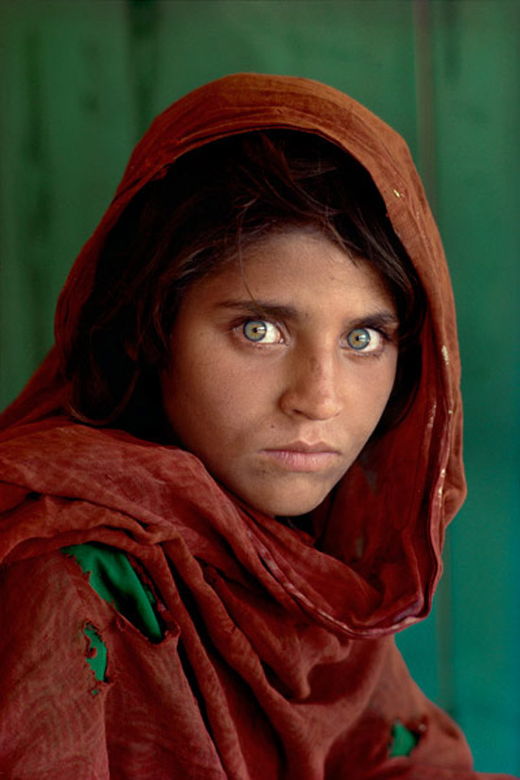
Steve McCurry has looked directly into the faces of people from all corners of this planet. From Afghanistan to Los Angeles and countless places in between, he has shot some of the most compelling photo portraits of our time. His direct and uncompromising style of shooting has produced memorable images, many of which have graced the cover and inside pages of National Geographic, including his well-known photograph of a young Afghan girl.

Slide 3
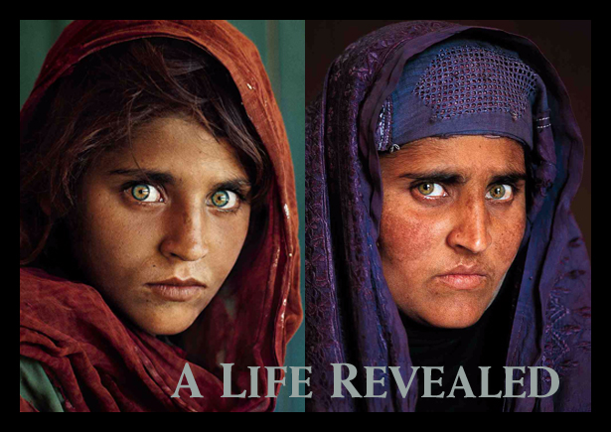

Slide 4
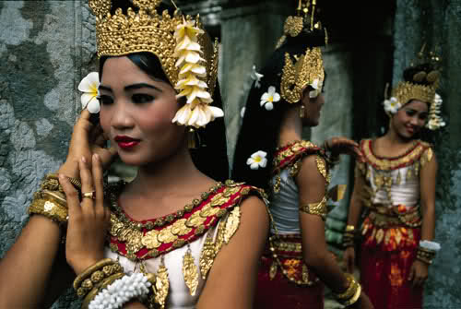

Slide 5
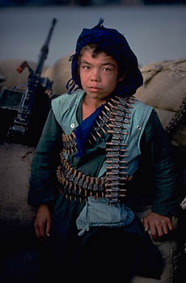

Slide 6
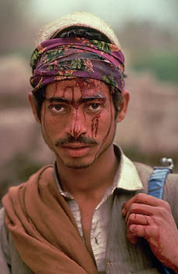

Slide 9
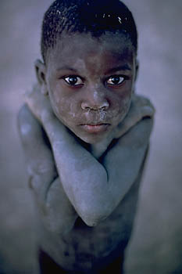

Slide 12
