Slide 1
Creative Shadow Photography

Slide 2
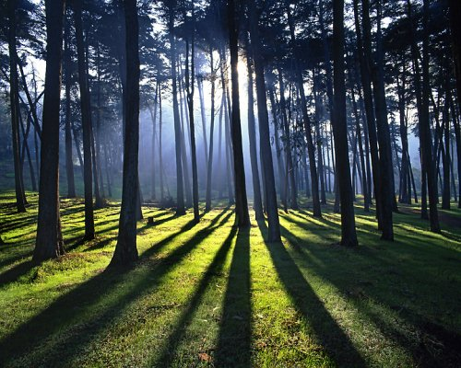
Elongated Shadows – low light source

Slide 3
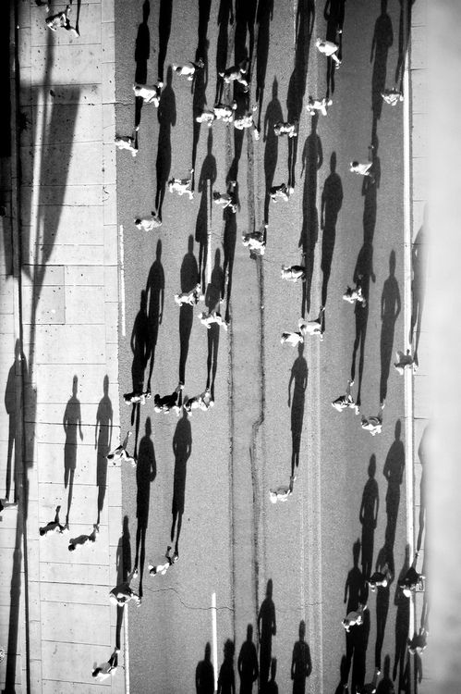
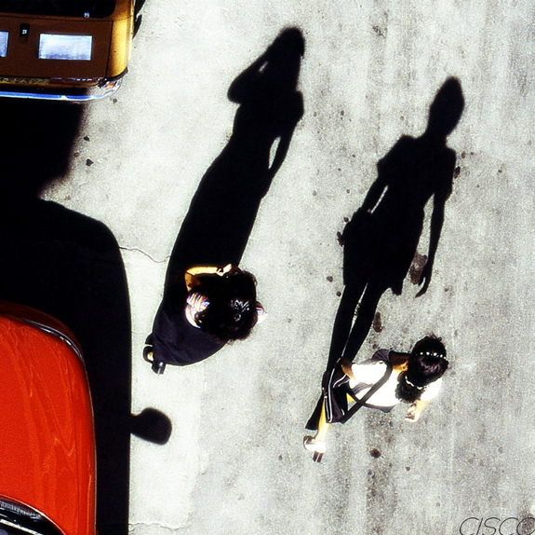
Elongated shadows – bird’s eye view from above

Slide 4
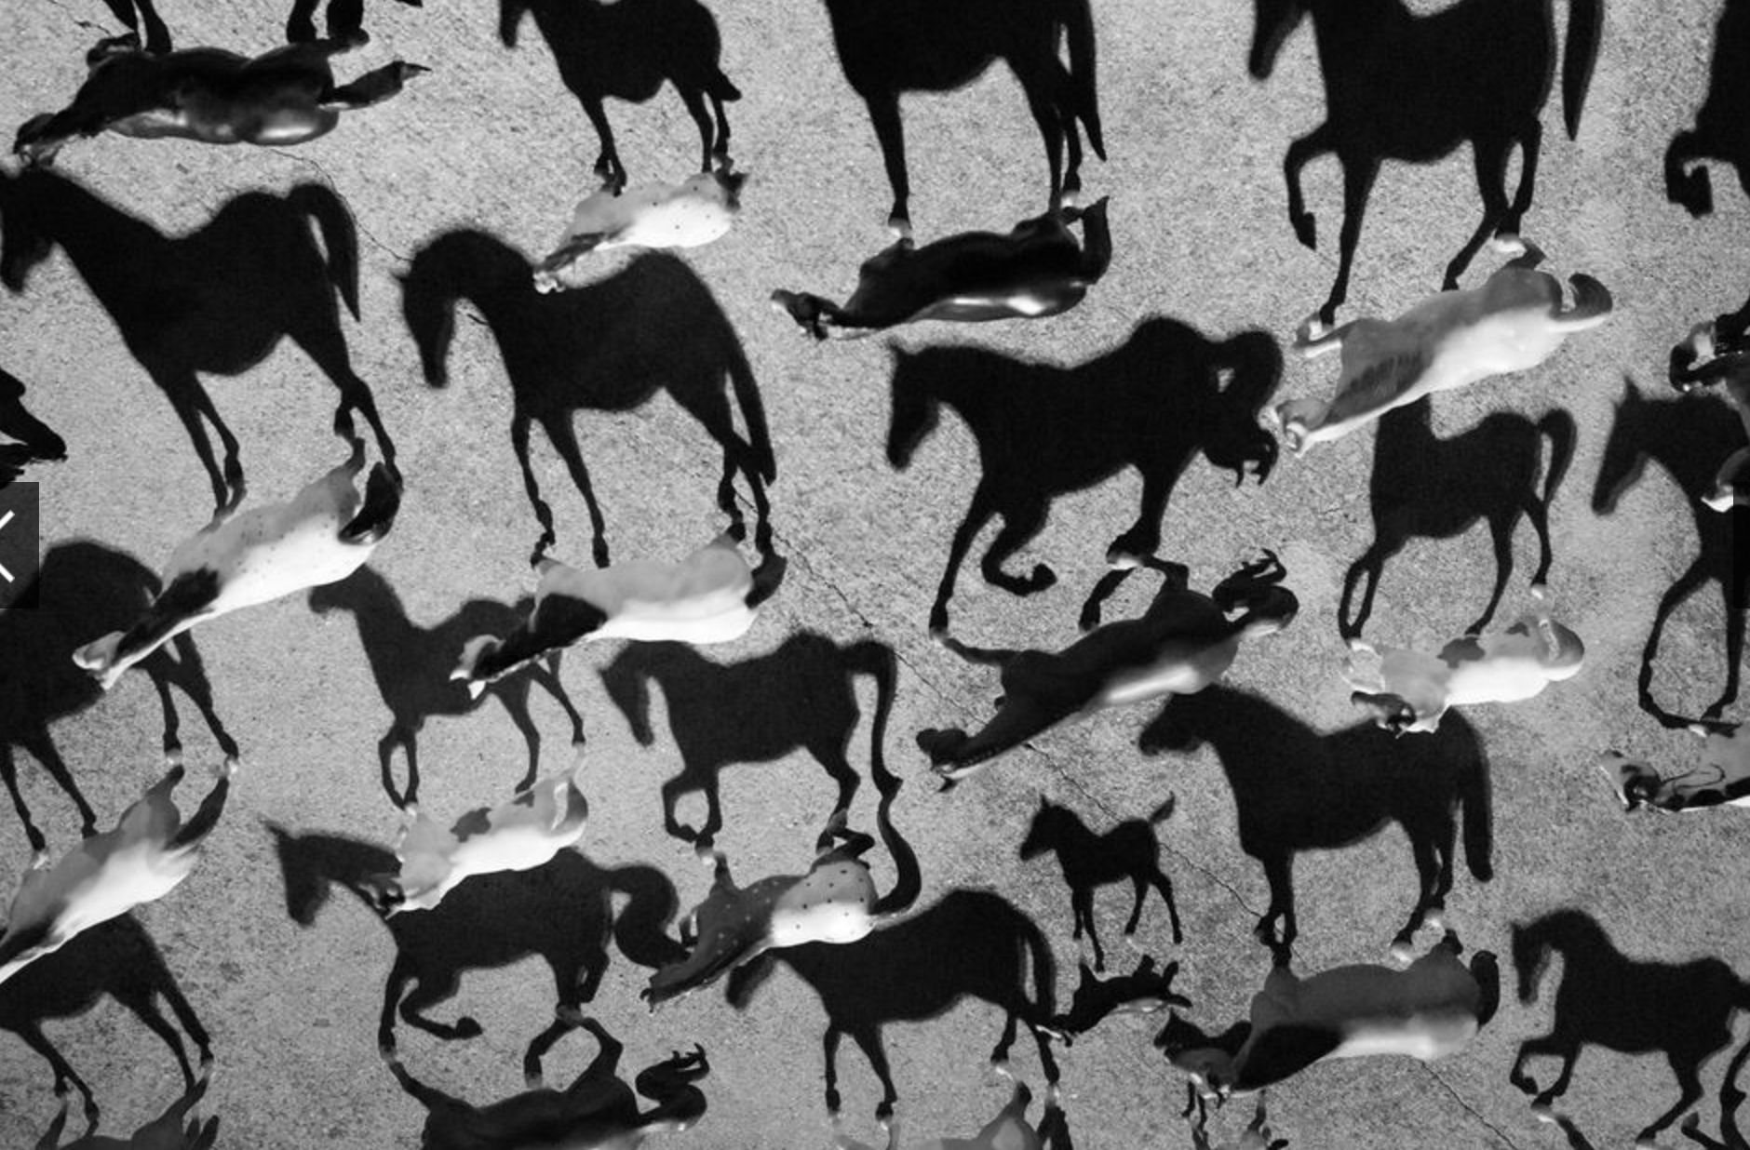
Elongated shadows – bird’s eye view from above

Slide 5
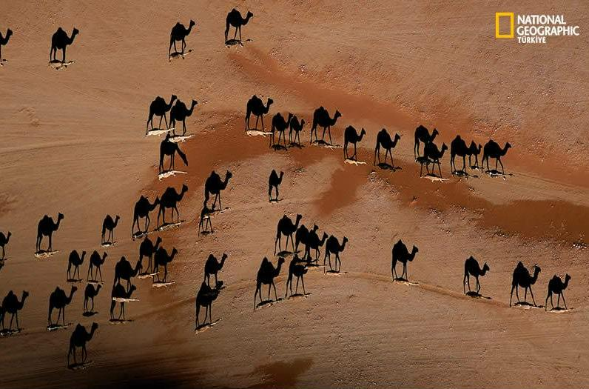
Elongated shadows – bird’s eye view from above

Slide 6
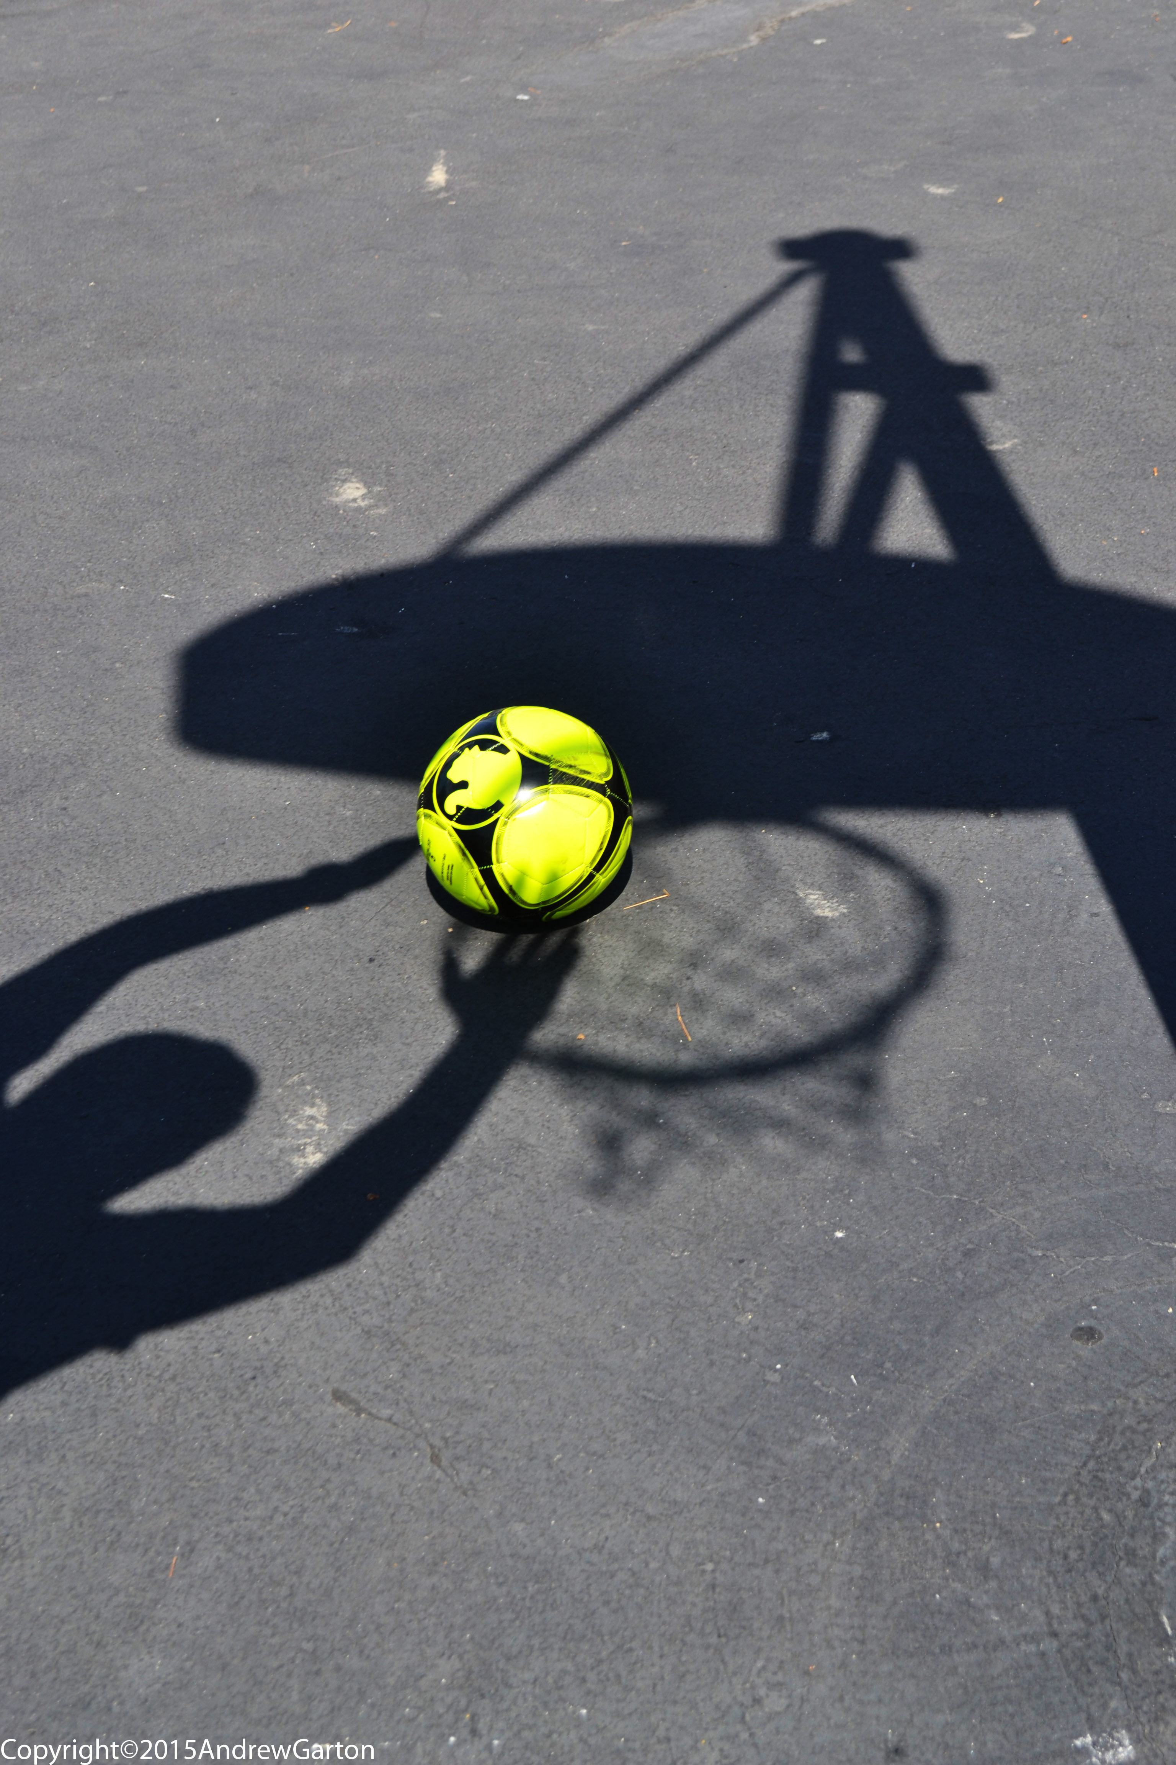
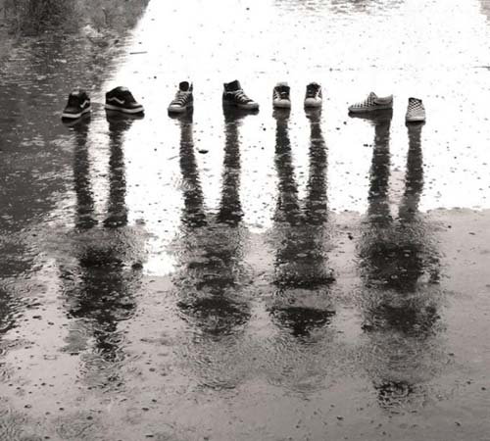
“The shadow that’s alive.” The shadow is interacting with something real.

Slide 7
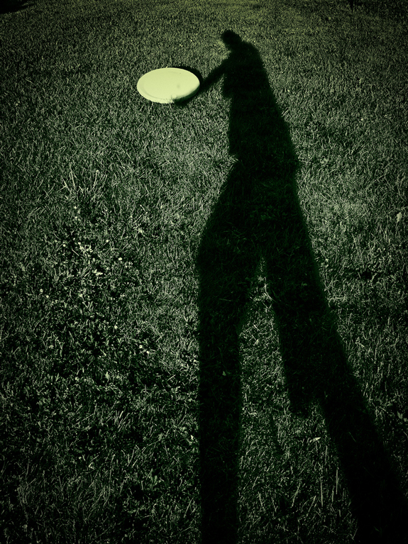
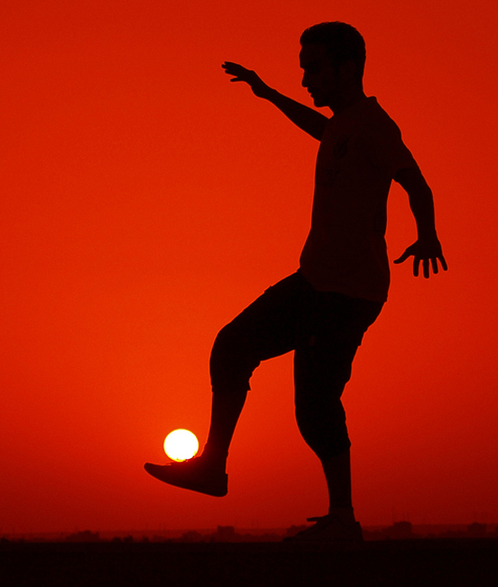
“The shadow that’s alive.” The shadow is interacting with something real.
Silhouette

Slide 8
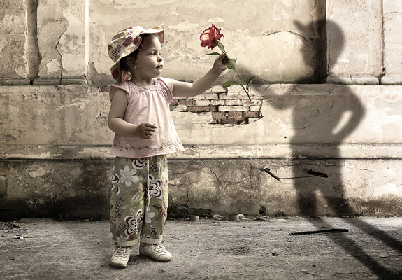
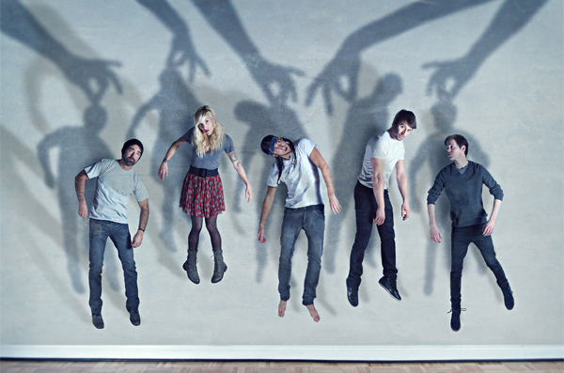
“The shadow that’s alive.” The shadow is interacting with something real.

Slide 9
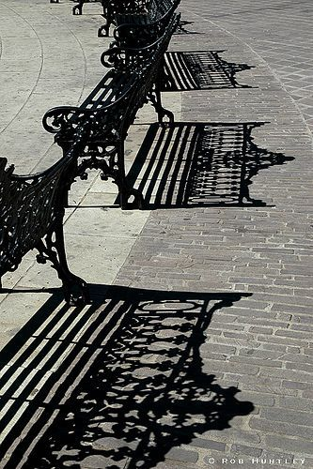
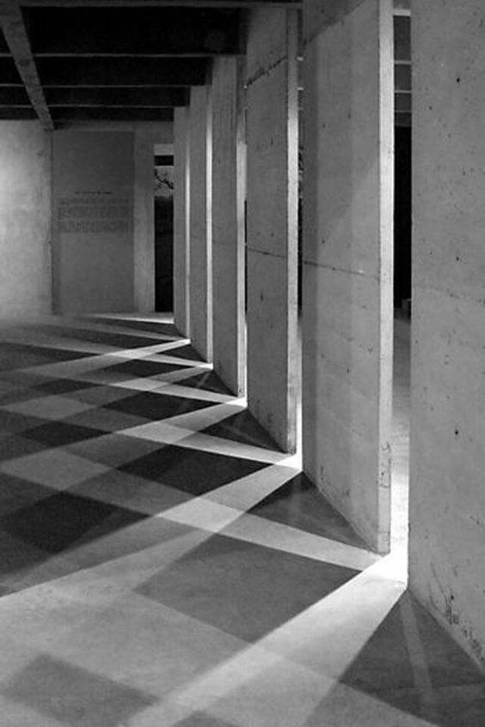
Create Abstract Shapes, Patterns, and Textures

Slide 10
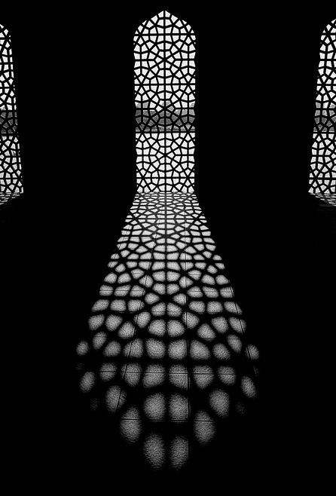
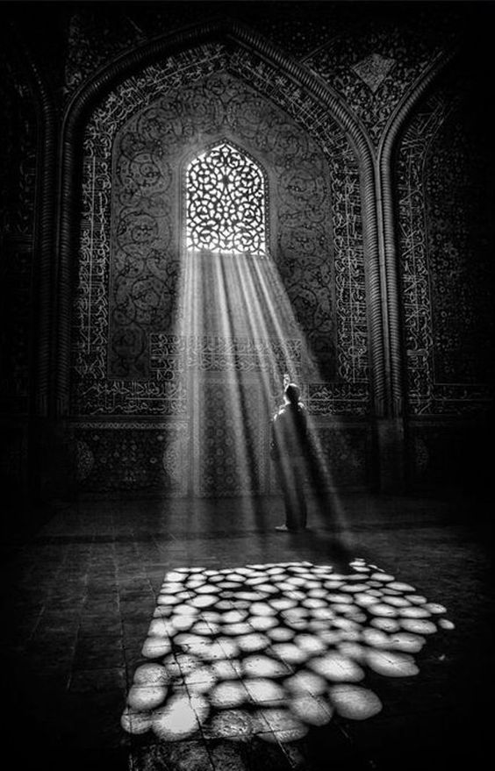
Create Abstract Shapes, Patterns, and Textures

Slide 11
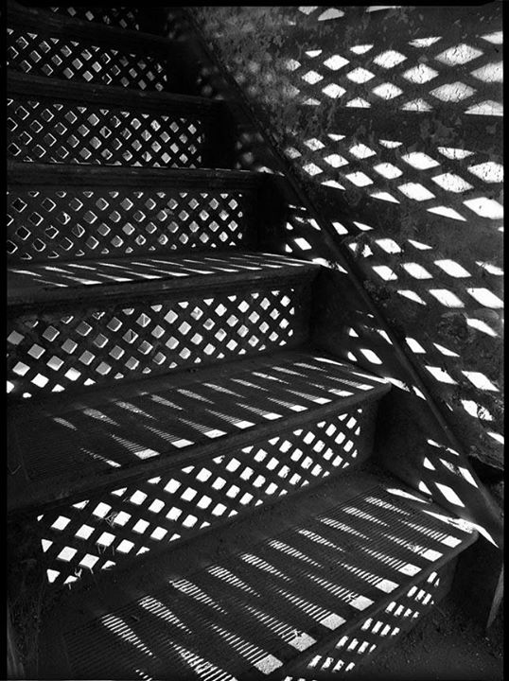
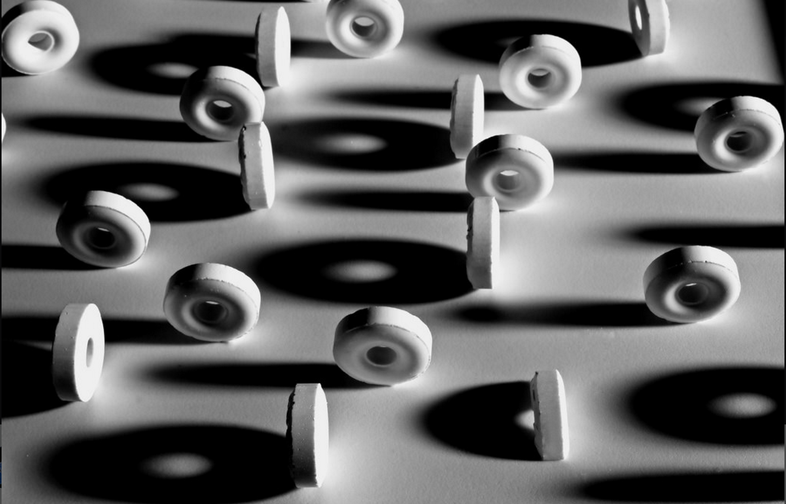
Create Abstract Shapes, Patterns, and Textures

Slide 12
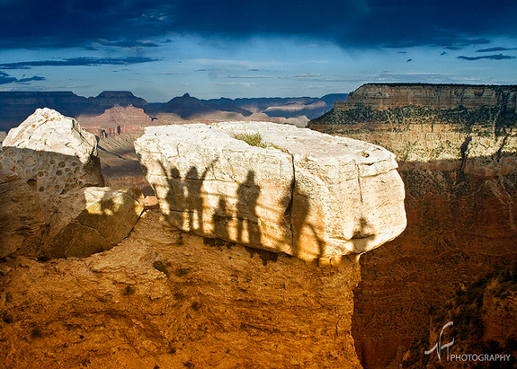
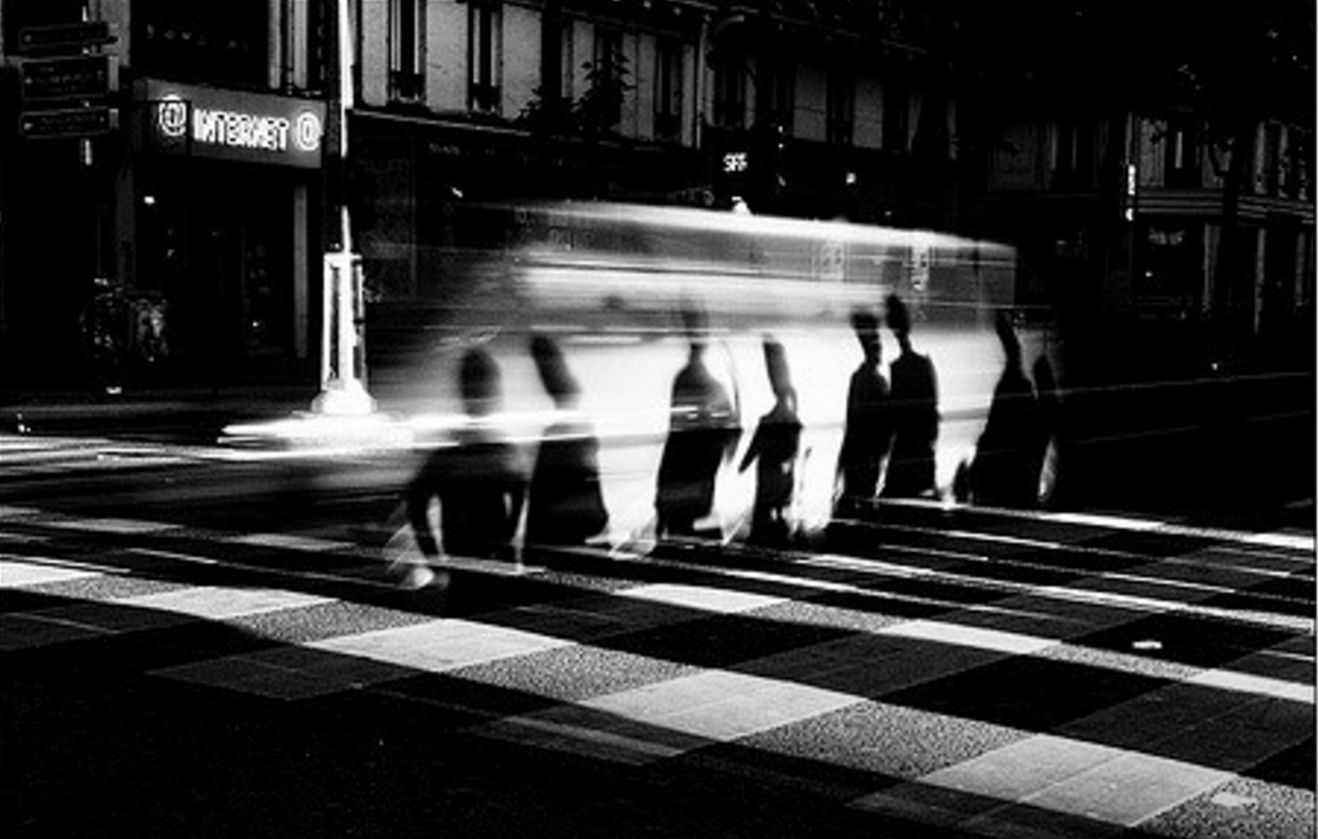
Cast Shadows onto Objects

Slide 13
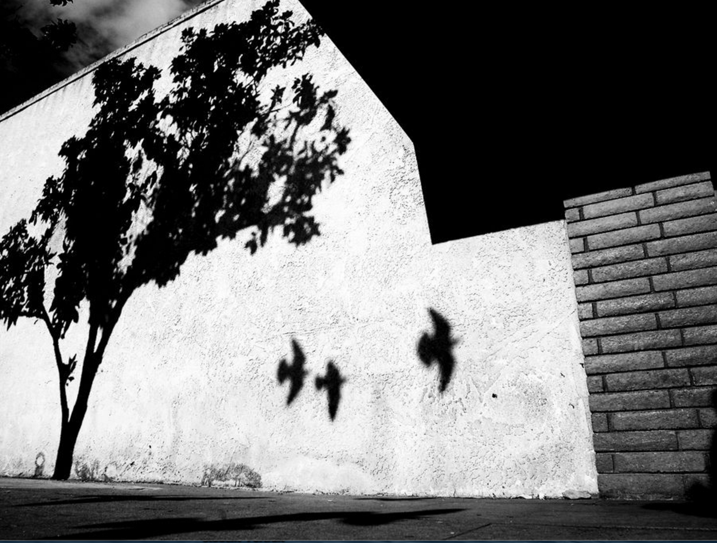
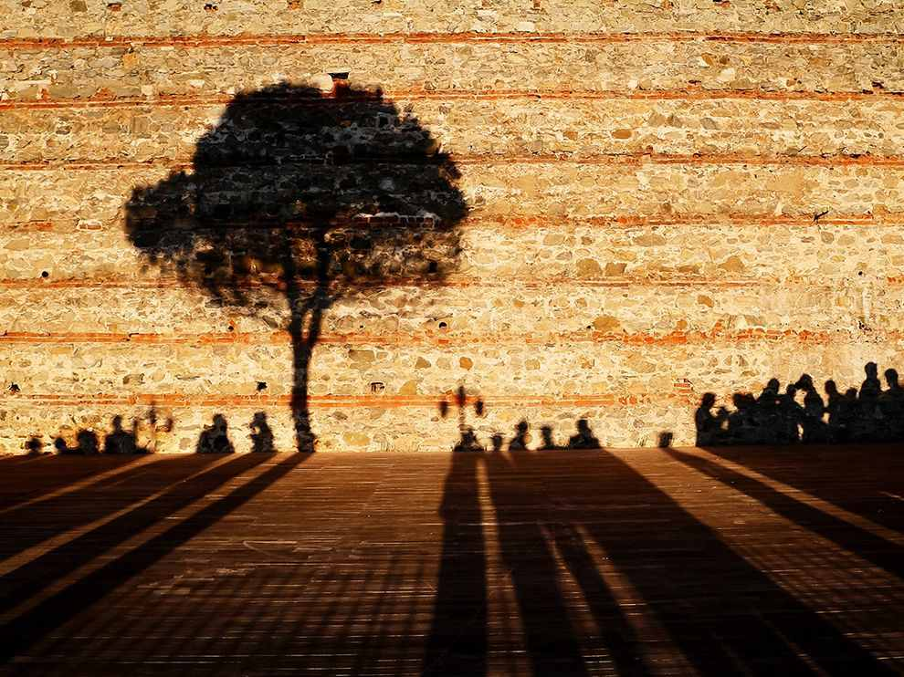
Cast Shadows onto wall, and elongated shadows

Slide 14
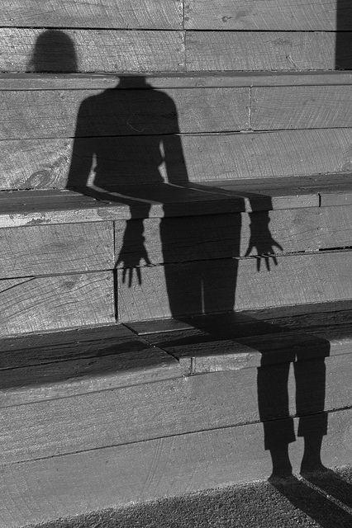
Cast shadow onto stairs-
Create illusion

Slide 15
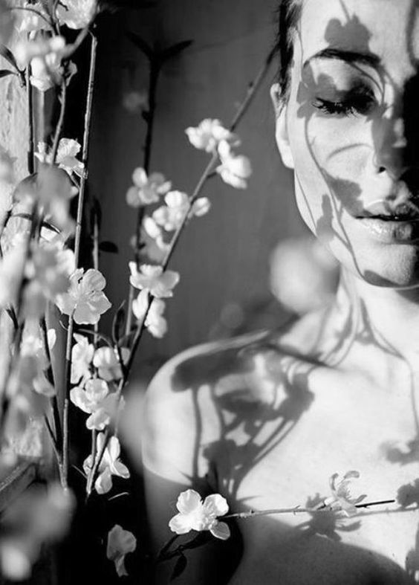
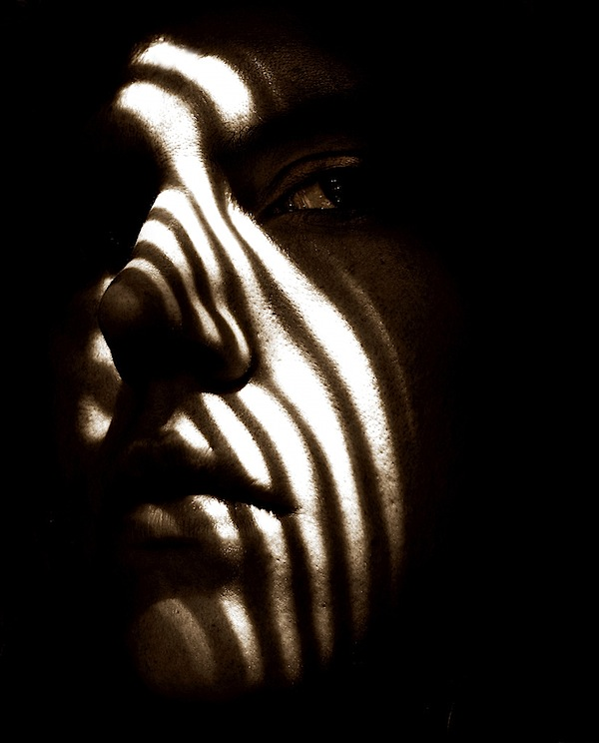
Cast Shadows onto People

Slide 16
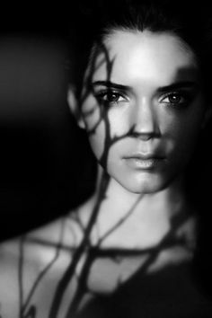
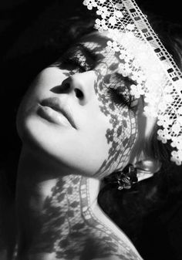
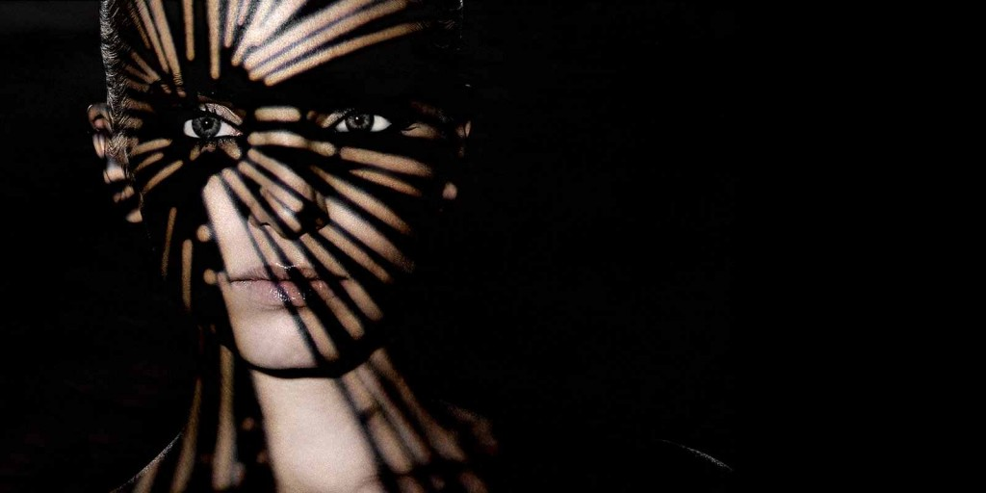
Cast Shadows
Onto People

Slide 17
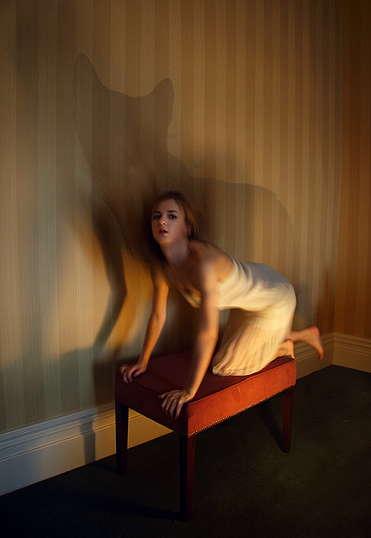
“Shadow with a Mind of its Own.” a subject with a shadow, but the shadow is a different shape / doing a different pose than the subject.

Slide 18
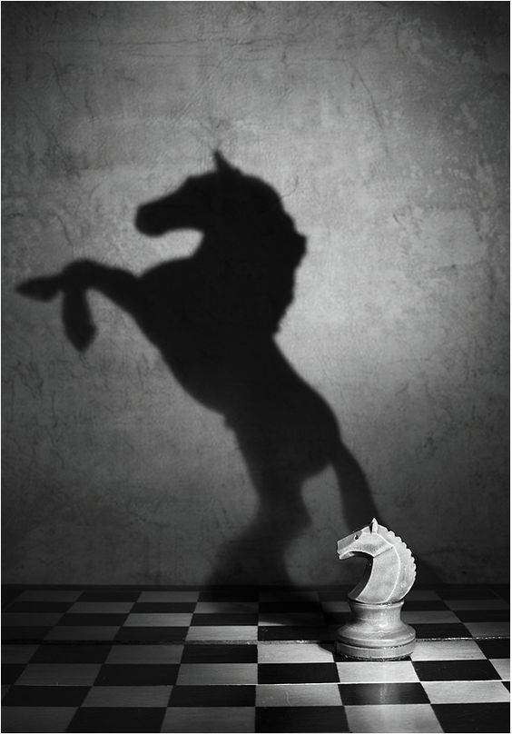
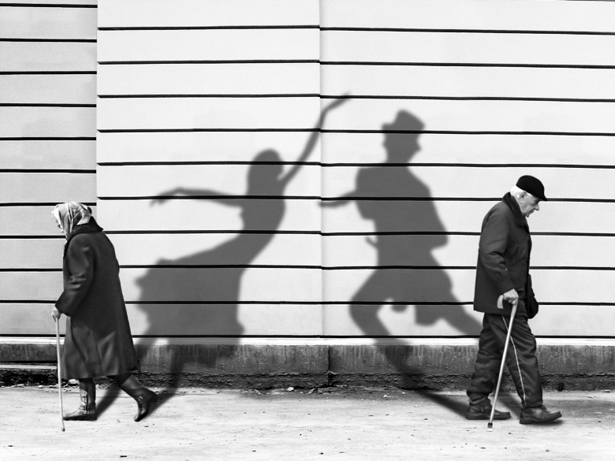
“Shadow with a Mind of its Own.” a subject with a shadow, but the shadow is a different shape / doing a different pose than the subject.

