Slide 1
Mixed Media Fiber Arts
Brand new class!
Learn how to weave with traditional and unconventional materials
Macramé – the art of tying knots
String Art – all grown up!
Painting with wool fibers
Dying textiles (fabrics) techniques
And much more!
If you like working with your hands and creating art you can hang in your house this class is for you

Slide 2
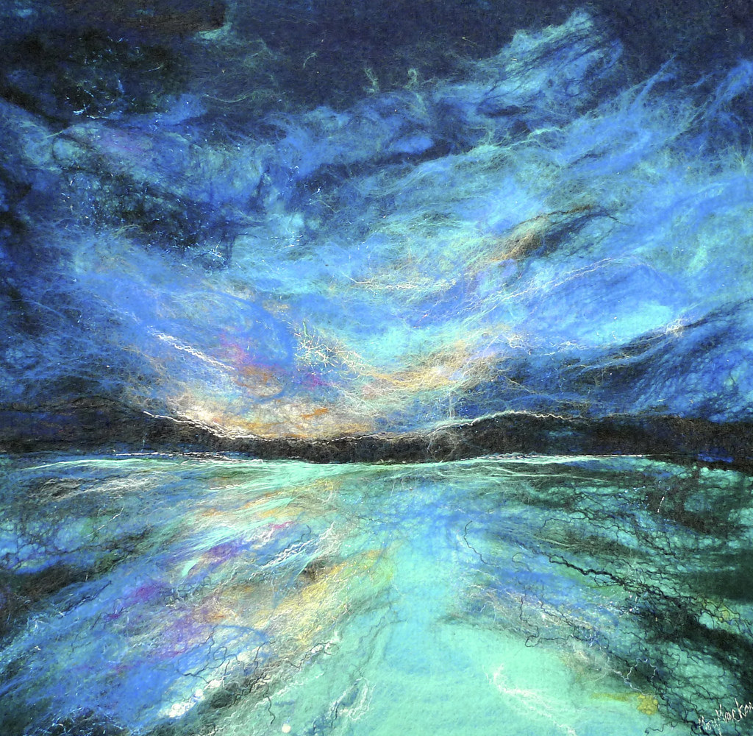
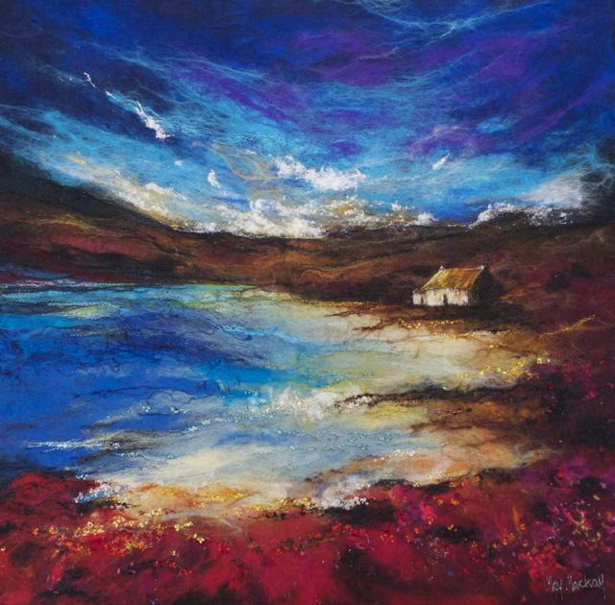
Wool Fiber “Painting” Landscapes and seascapes – no paint!
This is made with layered strands of wool

Slide 3
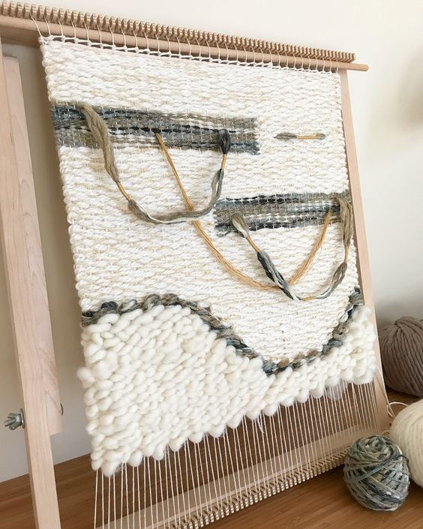
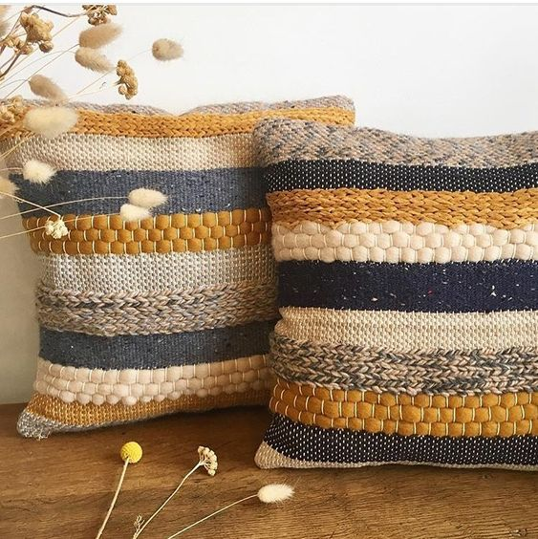
Learn traditional weaving techniques and how to turn them into functional objects like pillows and bags

Slide 4
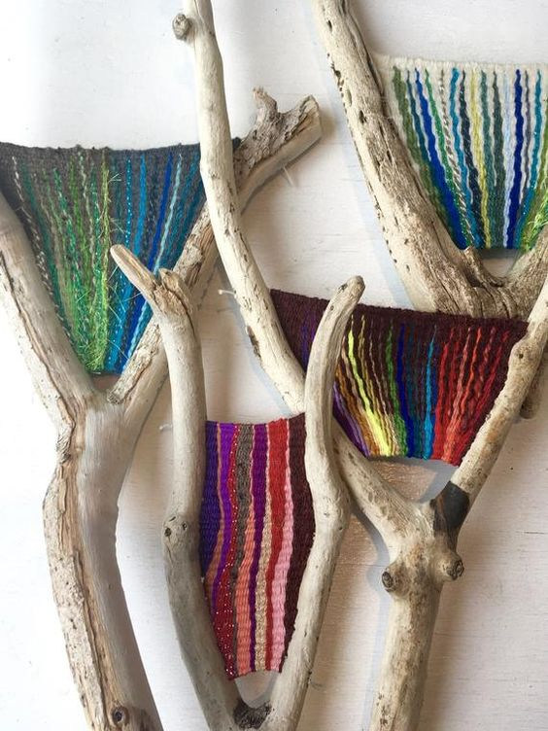
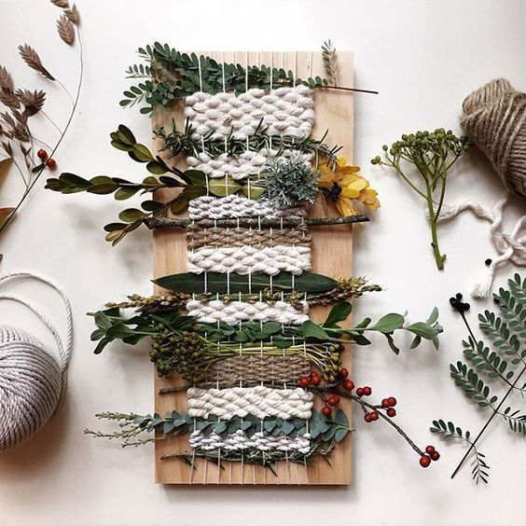
Modern Weaving: on tree branches and using leaves, flowers and rope

Slide 5
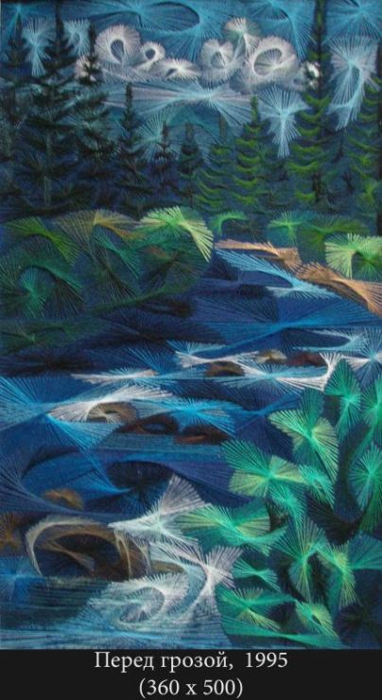
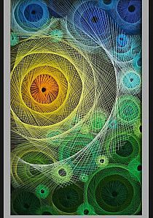
Learn how to do string art that looks like this!

Slide 6
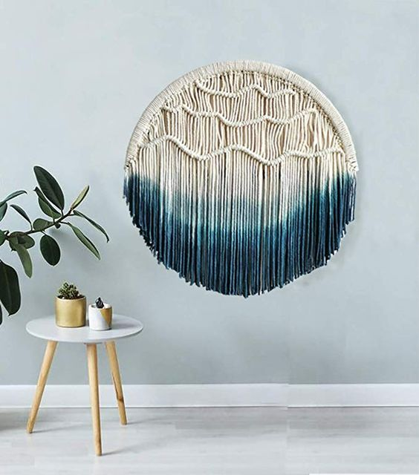
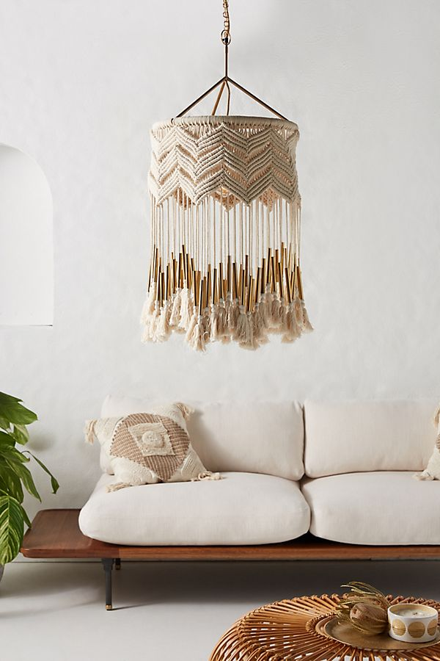
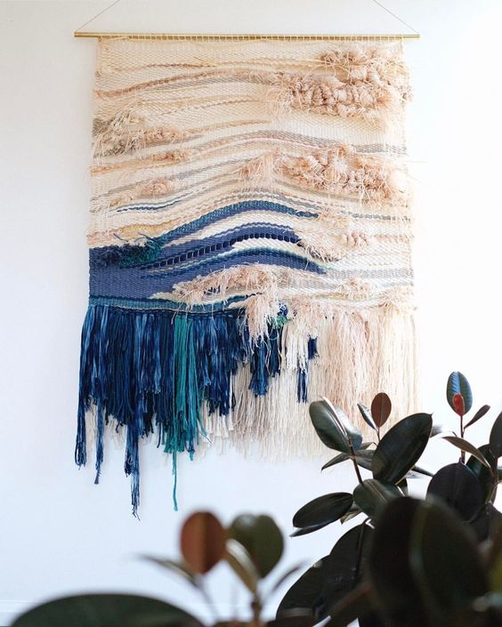
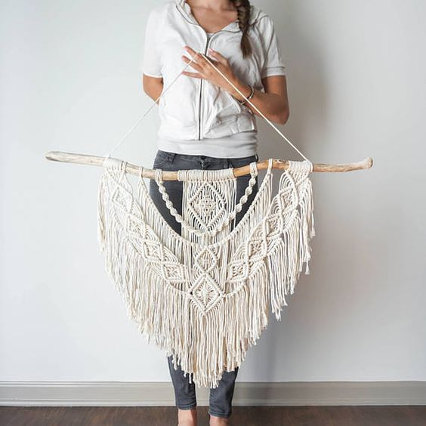
Learn macramé techniques and rope dip dye techniques

Slide 7
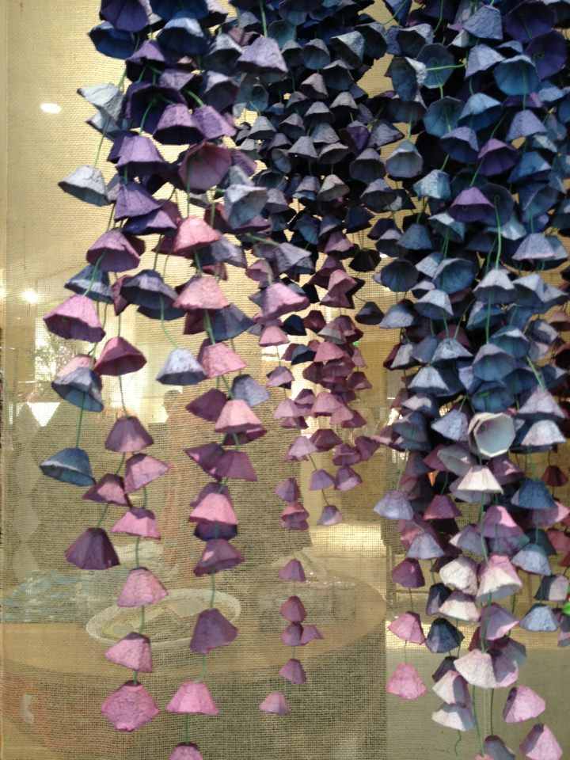
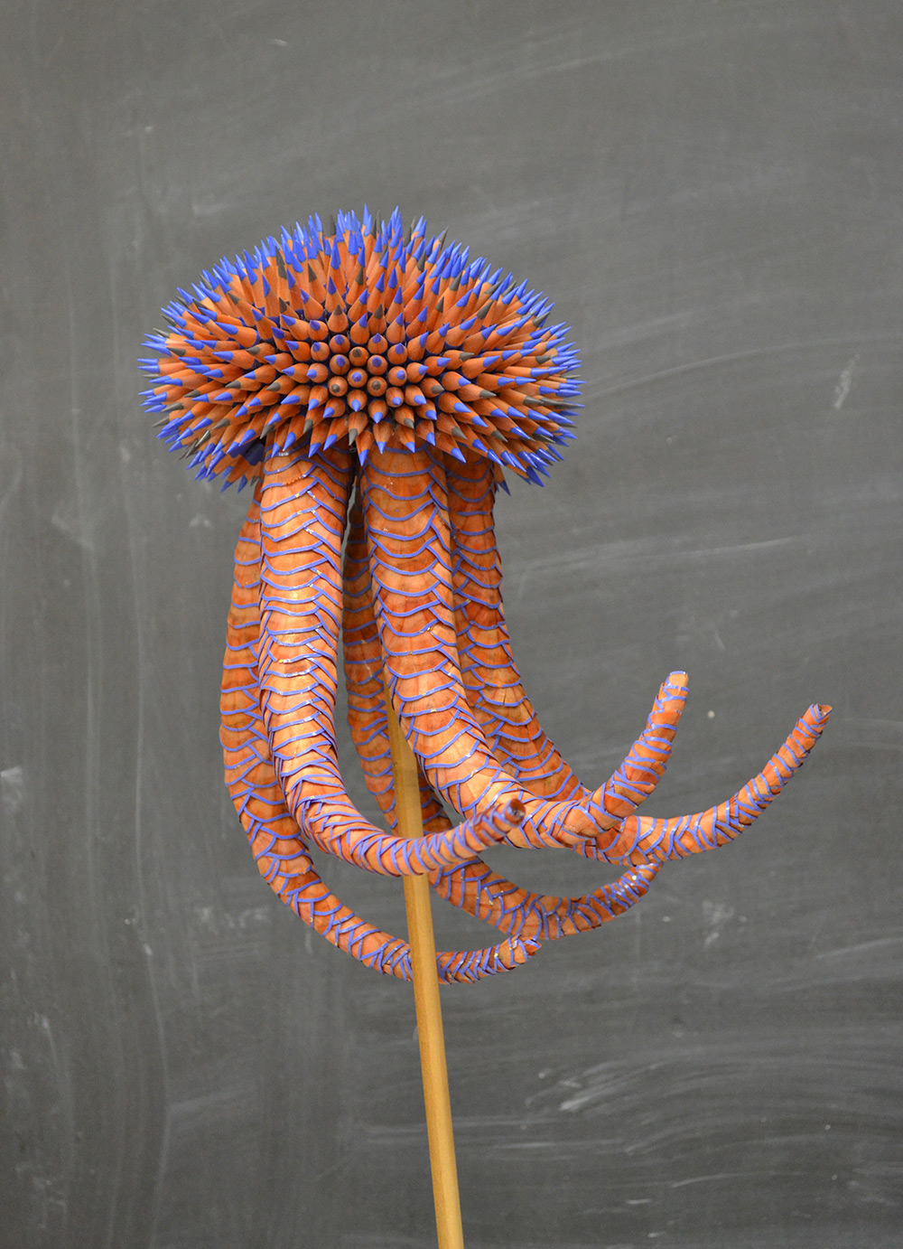
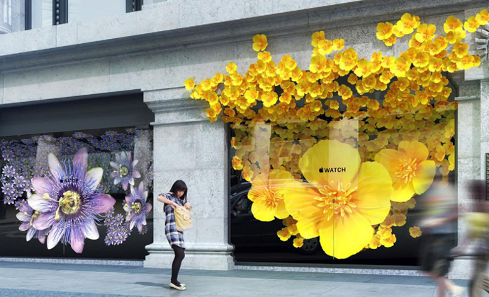
Use unconventional materials to make installations (public works) like egg crate hanging flowers and a jellyfish made out of colored pencils

Slide 8
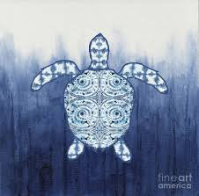
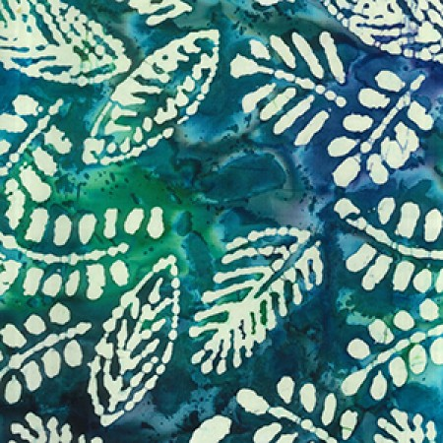
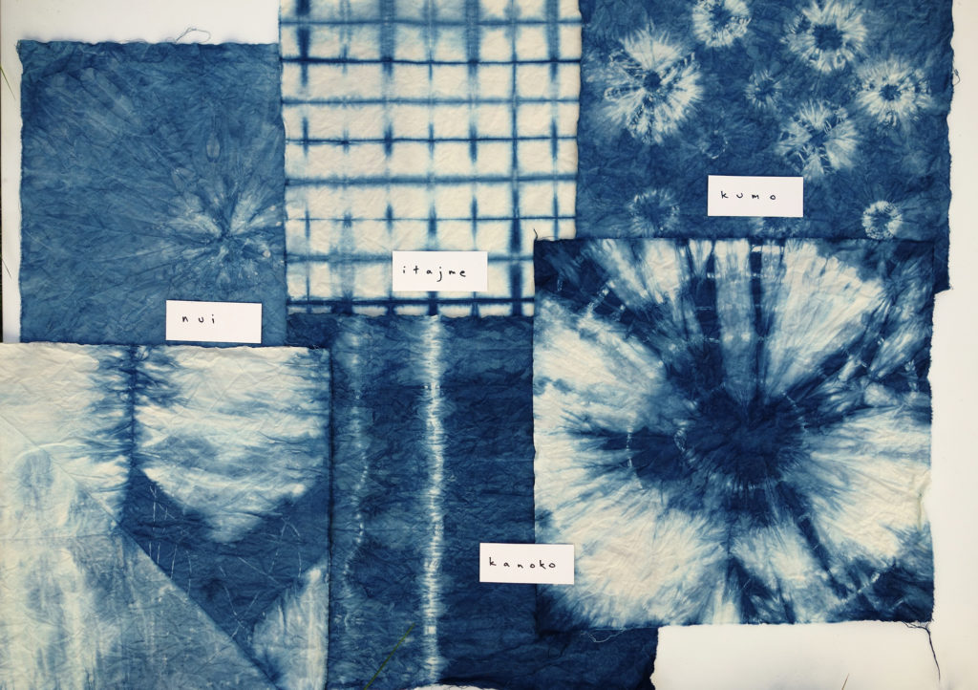
Learn textile dyeing techniques like tie dye, batik, and shibori

Slide 9
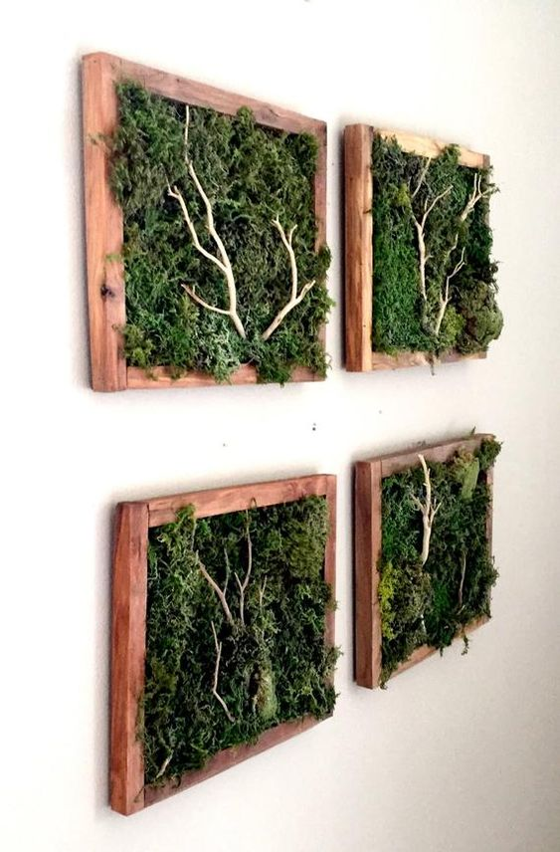
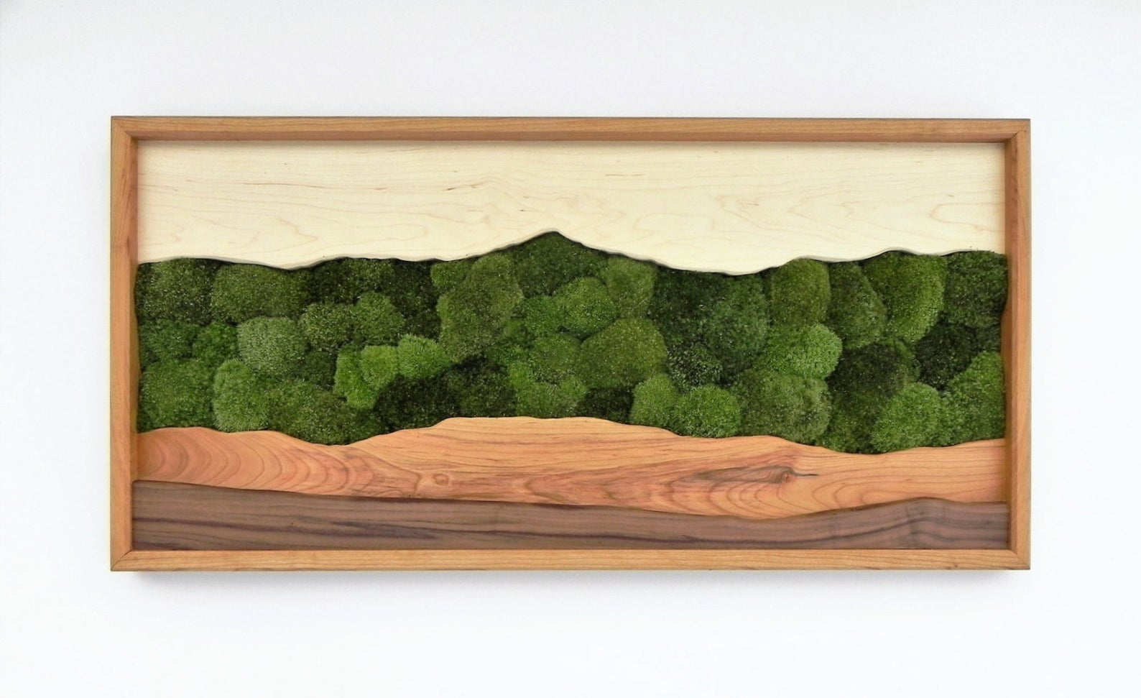
Create artworks out of unconventional media like moss, branches, and wood

