Slide 1
Abstract Bokeh Photos

Slide 4
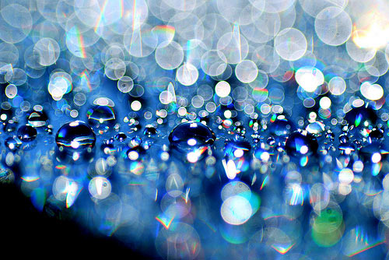

Slide 6
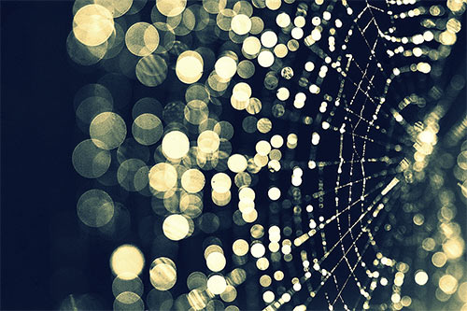

Slide 9
Bokeh Examples with a representational Foreground or Subject

Slide 10
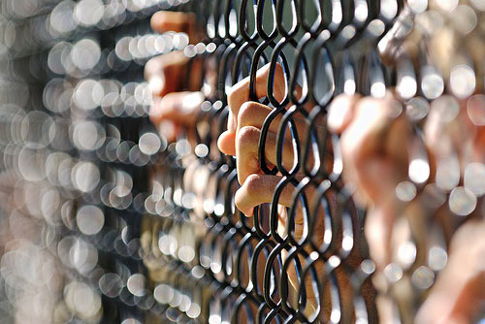

Slide 12
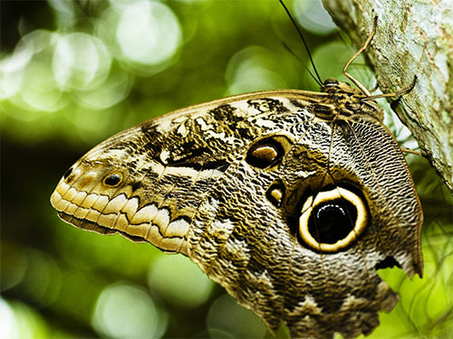

Slide 14
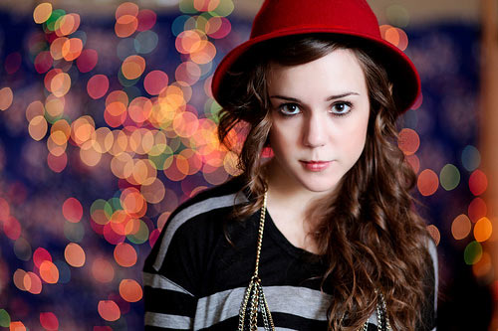

Slide 16
