Slide 1
MiraCosta College Admissions and Records Office
Returning Students:
Online Application Tutorial
Notes:
Welcome to MiraCosta’s Online application tutorial. We’re happy you have expressed an interest in becoming a Spartan and hope that these step-by-step instructions will assist you in completing our FREE online application through CCCApply.

Slide 2
Articulated high school courses: Things to kNow
You must earn an A or B in course and on final exam/project, plus be recommended for credit
MiraCosta faculty grade portfolios and recommend for credit in our Media Arts and Technologies (MAT) articulated courses
We don’t transcript grades of C or lower
We transcript your final exam/project grade because articulation is Credit by Exam
You must submit a current Spring application (even if you did one before) and register in CATEMA (our online rosters) for MiraCosta to be able to transcript the credit
For more information, visit out CTE Transitions link
https://www.miracosta.edu/academics/cte-transitions

Slide 3
MCC Online Application
Before you begin, you may want to gather some information that may be asked in the application. (Use your checklist if you completed it)
Social Security Number (if you have one)
Home Address
High School Transcript (12th graders only)
Depending upon when you graduated from high school, the MiraCosta CCCApply application may ask you to provide the following:
High school GPA
Highest high school math/English course completed
High school math/English coursework and grades
Permanent Resident Card (aka: Green Card)
Pen and paper. You will be creating a login and password
along with three security questions
Notes:
Before you begin the application we recommend that you have the following items available:
Your social security number,
12th graders need a copy of your high school transcript (if you don’t have a copy that’s ok but you may be asked your High School GPA and some basic information about your English and Math courses).
Your Permanent Resident Card (otherwise known as Green Card)
A pen and paper because you will be creating a login and password along with three security questions

Slide 4

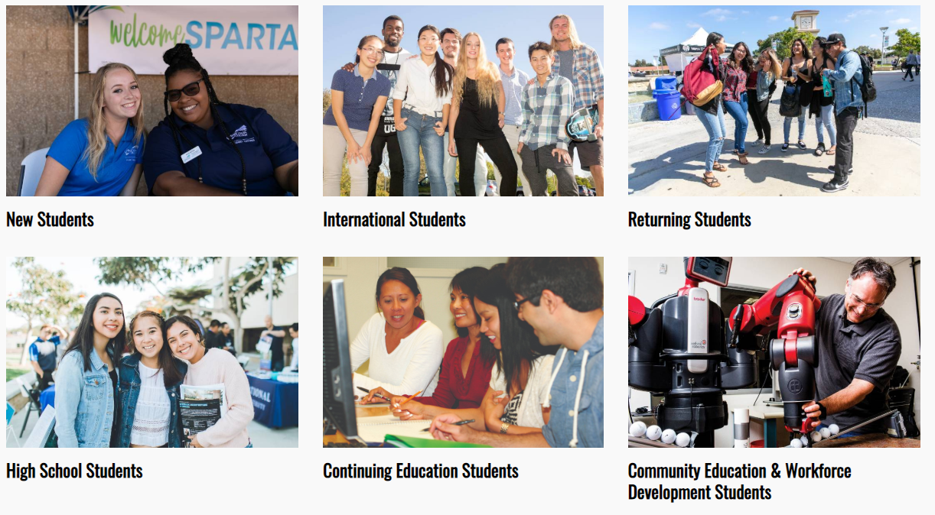
MCC Online application
Step 1: Go to miracosta.edu
Step 2: Click on
Step 3: Select which type of student applies to you!
Notes:
First, go to MiraCosta.edu and click on the ‘Apply Now’ button.
Then, click on High School Students

Slide 5
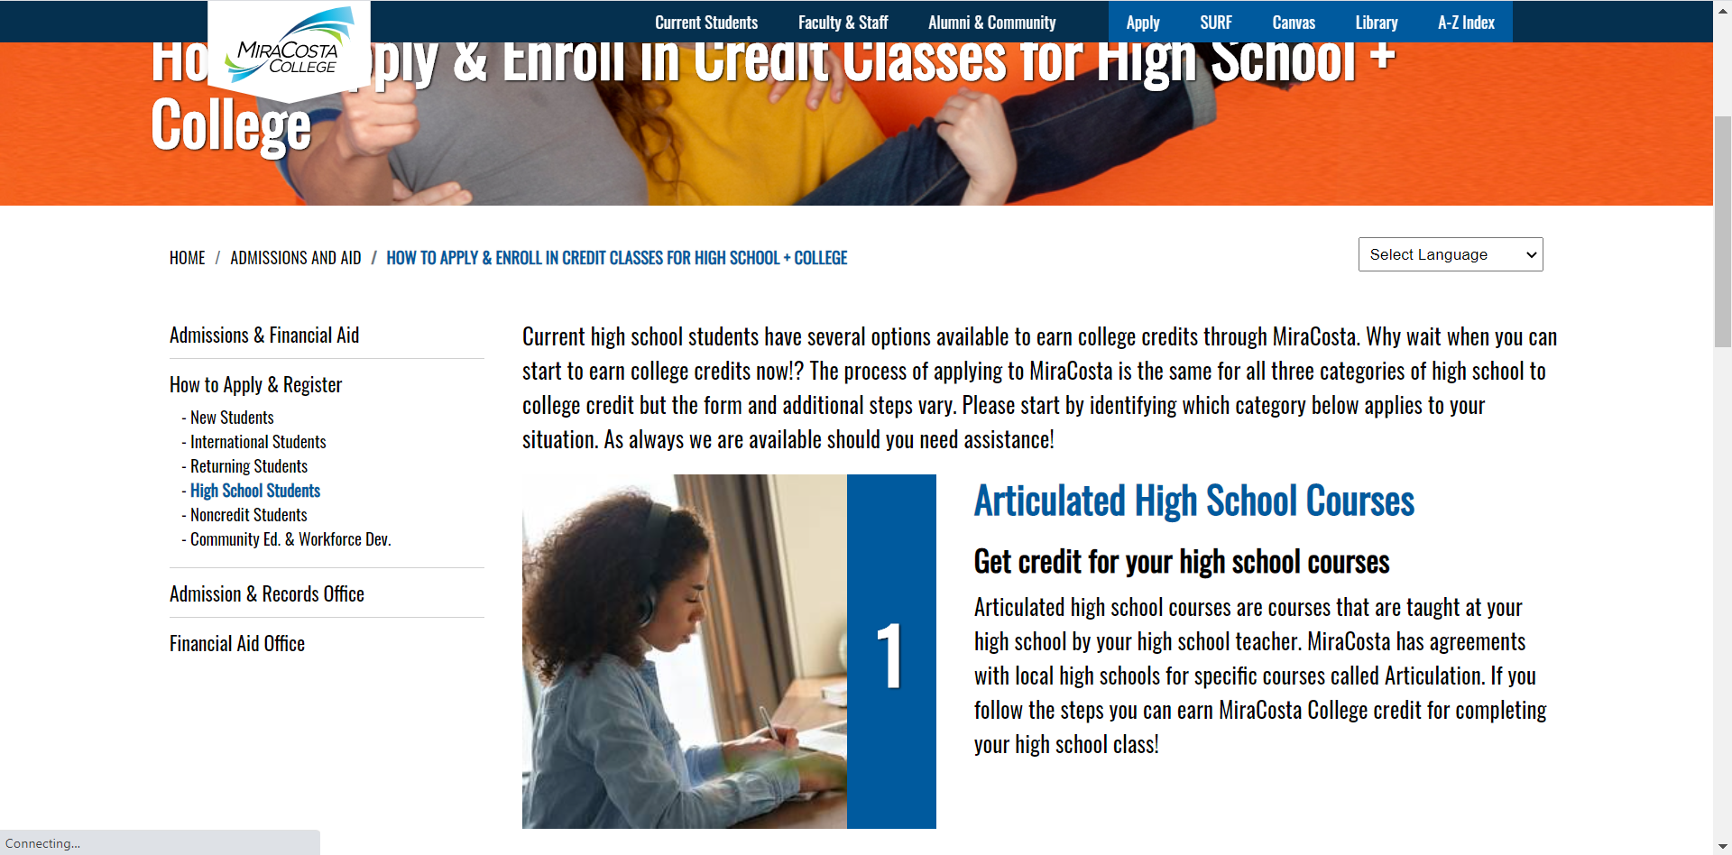
Mcc online application
Click on “Articulated High School Courses”

Slide 6
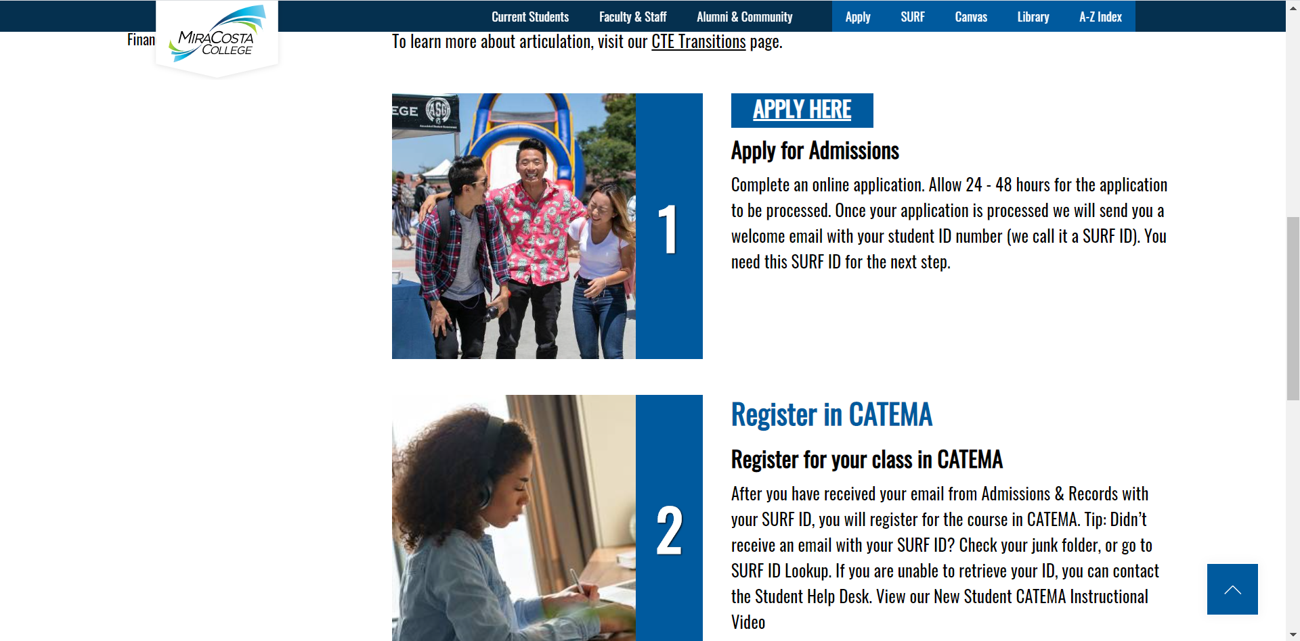
Mcc online application
Click on “Apply Here”

Slide 7
MCC online application
Hold for new slide to show instructions for HS Student Type

Slide 8
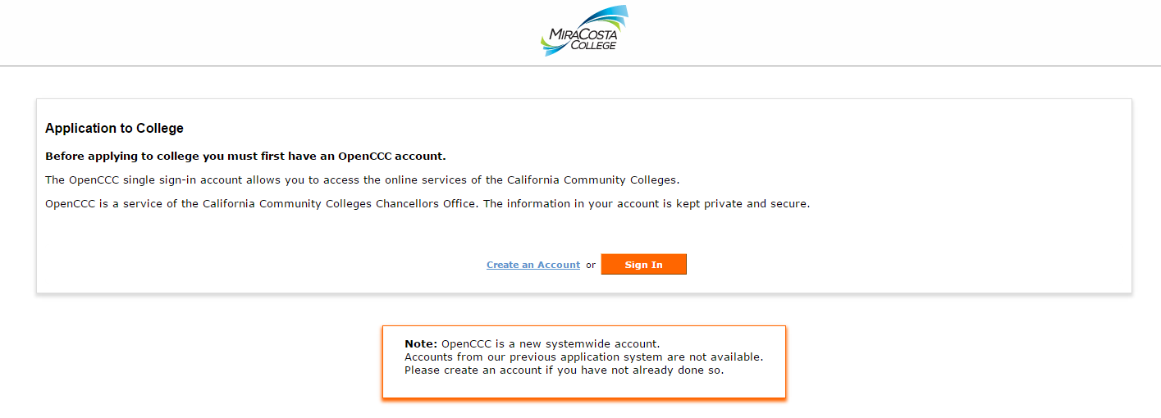
MCC Online application
First you have to create a CCCApply Account, then you can fill out an application.
It’s a 2-step process.
Returning applicants
Notes:
First time applicants, click on “Create an Account.”
Returning students (anyone who’s completed an application in the past)—click on “Sign In”

Slide 9
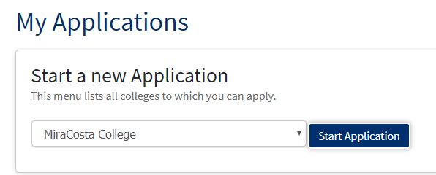
MCC online application
To start your MiraCosta Application select MiraCosta College from the drop down menu and click ‘Start Application’
Notes:
Select MiraCosta College from the drop down menu and click ‘Start Application’

Slide 10
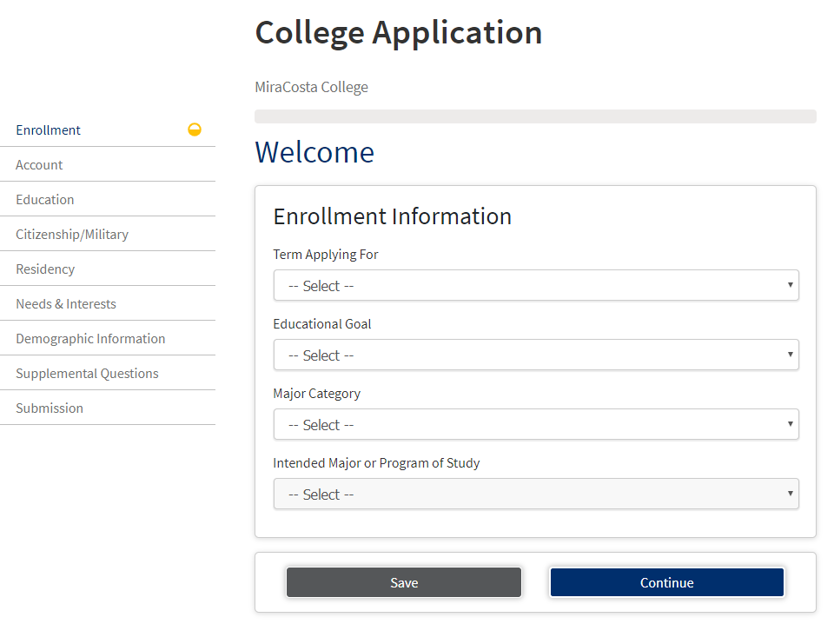
MCC Online application
Select Spring 2021
Unsure? Visit Miracosta.edu/ACP
9 pages to complete application
Use these tabs to navigate between pages
Check appears when page is complete
Unsure? Visit miracosta.edu/academics to explore careers
Notes:
Total of 9 pages to complete. Check appears when that page is done.
Students in articulated courses MUST submit a Spring application
Selections for Educational goal, Major Category, or Intended Major has no impact on students earning credit

Slide 11
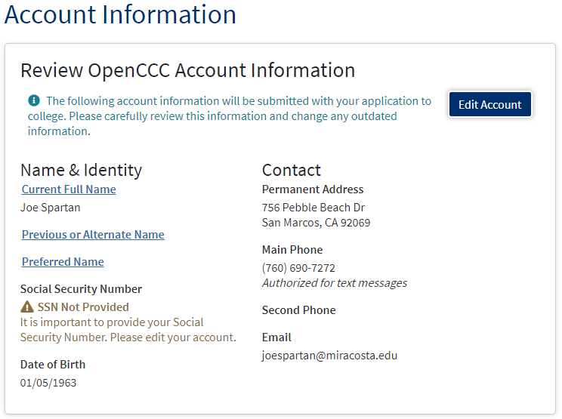

MCC Online application
The Account Information section gives you a snapshot of what’s in your CCCApply Account (remember, that’s the one you just got done creating) and it gives you the chance to edit the information if you need to).
Notes:
The Account Information section gives you a snapshot of what’s in your CCCApply Account (remember, that’s the one you just got done creating) and it gives you the chance to edit the information if you need to).

Slide 12
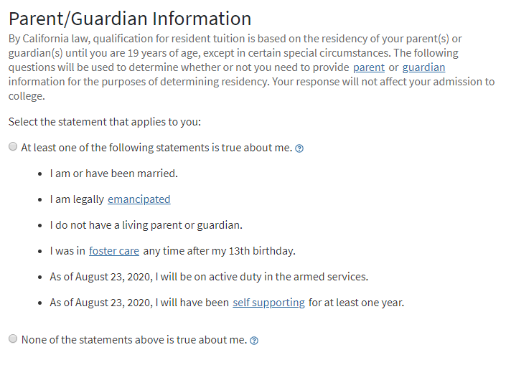
MCC online application
Select the option that is correct for you. Depending upon what you select you may be asked to complete additional information.
Notes:
Select the option that is correct for you. Depending upon what you select you may be asked to complete additional information.

Slide 13
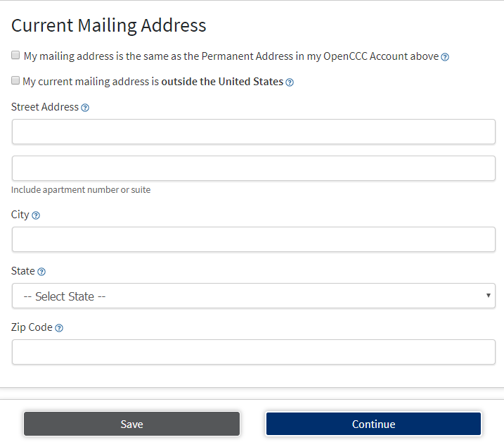
MCC Online Application
If your mailing address is the same as your Permanent address, simply check the first box.
If your mailing address is different from your permanent address, this is where you will let us know what your mailing address is.
Click here
Notes:
If your mailing address is the same as your Permanent address, simply check the appropriate box, otherwise this is where you will let us know what your mailing address is.
When you are finished click continue.

Slide 14
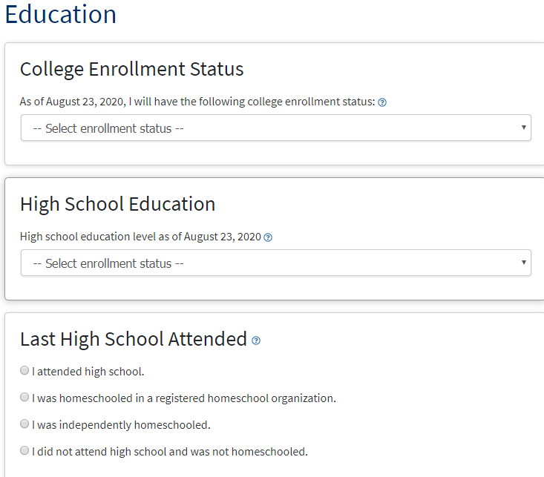
MCC Online application
Select:
“Enrolling in High School (or lower grade) and college at the same time.”
Notes:
This section is pretty straightforward but
On the first question, select Enrolling in High School (or lower grade) and college at the same time.
Enter your current high school or the high school you most recently attended.

Slide 15
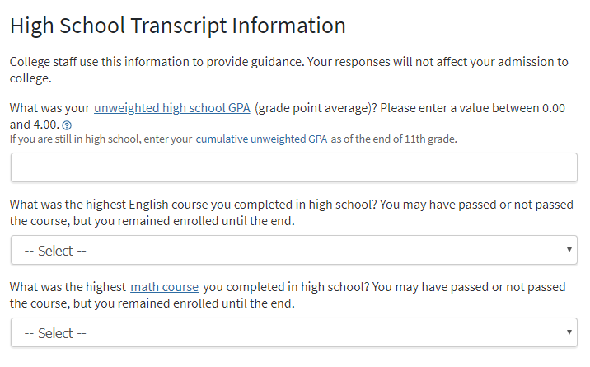

MCC Online application
Only 12th Graders will be shown this screen.
Notes:
Depending upon your answers to the previous questions about your high school, you may see the questions above about your high school GPA and the highest level of English and Math you took. We will use the answer to these questions to place you into your English and Math Courses at MiraCosta. When you are done, click continue.

Slide 16
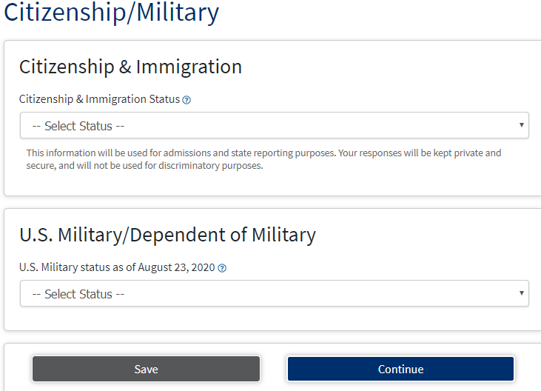
MCC Online Application
You DO NOT have to be a US Citizen to take classes at MiraCosta. If you are undocumented you may want to connect with our Uprise program! For more information go to: miracosta.edu/Uprise.
Permanent Residents and Visa holders will need to input their identification number.
Dependents of Veterans will need to know type and date of discharge.
Click here
Notes:
Select the Citizenship status that applies to you. Remember, you DO NOT have to be a US Citizen to take classes at MiraCosta. If you are undocumented you may want to connect with our Uprise program! For more information go to: miracosta.edu/Uprise.

Slide 17
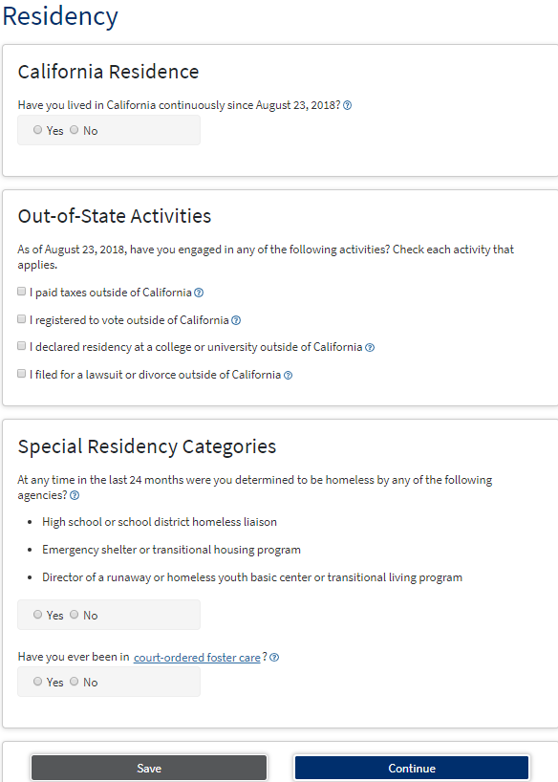
MCC Online application
Your answers in the Residency portion of the application may prompt the application to ask additional questions.
The application is responsive to your answers and will only display questions that apply to your specific situation. Answer all questions as completely and accurately as possible.
This section is typically one of the sections that can take a little bit longer so take your time and don’t give up!
Click here
Notes:
Your answers in the Residency portion of the application may prompt the application to ask additional questions. The application is responsive to your answers and will only display questions that apply to your specific situation. Answer all questions as completely and accurately as possible. This section is typically one of the sections that can take a little bit longer so don’t give up! Remember that if you run into questions we are here to assist you!

Slide 18
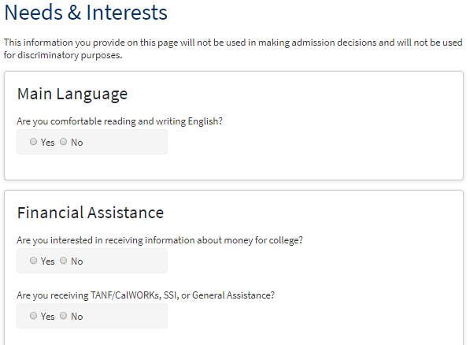
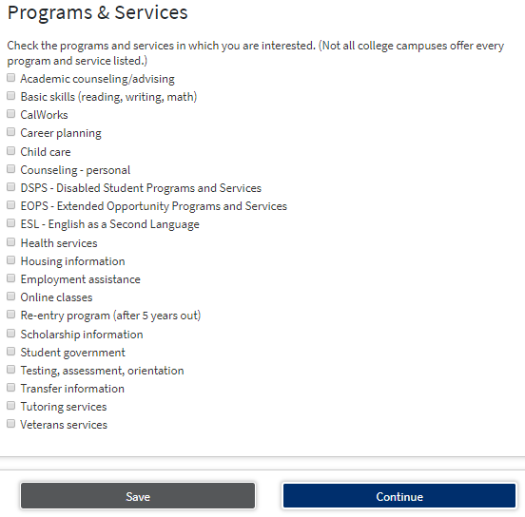
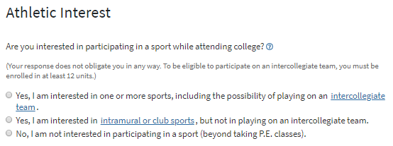
MCC Online application
Click here
The Needs & Interests Section is here so we can capture the types of activities and services that you may need once you are a student.
There’s no penalty for answering any of these question in a certain way and you are always free to change your responses at any time.
Notes:
The Needs & Interests Section is here so we can capture the types of activities and services that you may need once you are a student.
There’s no penalty for answering any of these question in a certain way and you are always free to change your responses at any time.

Slide 19
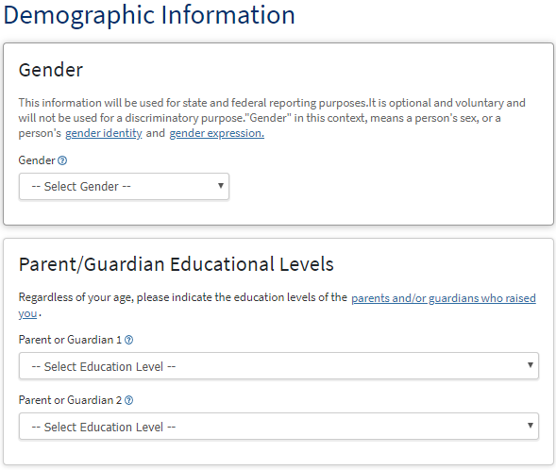

MCC Online application
MiraCosta is required to gather the information in this section because we want to be sure that we are providing the support our students need to be successful.
MiraCosta College has an expressed commitment to equity and inclusion for students, faculty and staff members who are lesbian, gay, bisexual, transgender, queer/questioning, intersex, and asexual (LGBTQIA).
Demographic Information (1 of 2)
You may not be 100% sure about the educational levels of your parents but we are hoping that you will give us your best estimate!
Notes:
MiraCosta is required to gather the information in this section because we want to be sure that we are providing the support our students need to be successful.
MiraCosta College has an expressed commitment to equity and inclusion for students, faculty and staff members who are lesbian, gay, bisexual, transgender, queer/questioning, intersex, and asexual (LGBTQIA).
You may not be 100% sure about the educational levels of your parents but we are hoping that you will give us your best estimate!

Slide 20
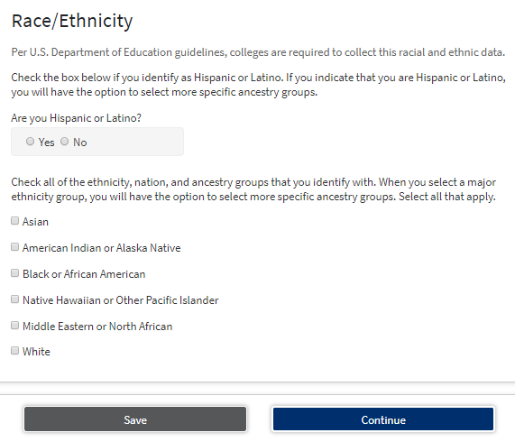
MCC Online application
Demographic Information (2 of 2)
Your answers to the Race/Ethnicity questions may signal the application to provide you with additional ‘subcategories’. Please feel free to select all that apply.
Click here
Notes:
Your answers to the Race/Ethnicity questions may signal the application to provide you with additional ‘subcategories’. Please feel free to select all that apply.
When you are done click ‘Continue’

Slide 21
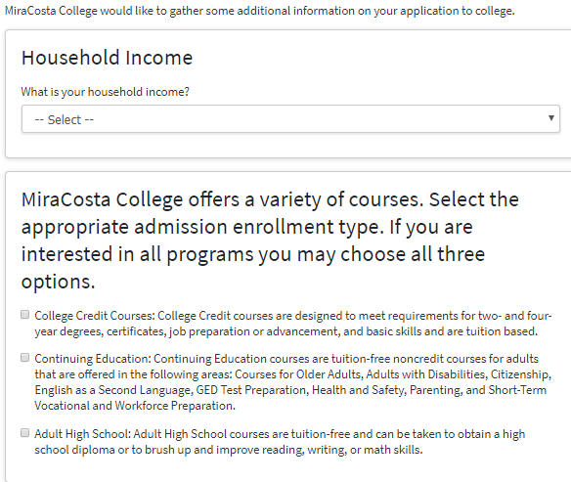
MCC Online application
Supplemental Questions (1 of 2)
Ask your parents/guardians if you are unsure.
Notes:
Students in articulated courses should select College Credit Courses

Slide 22
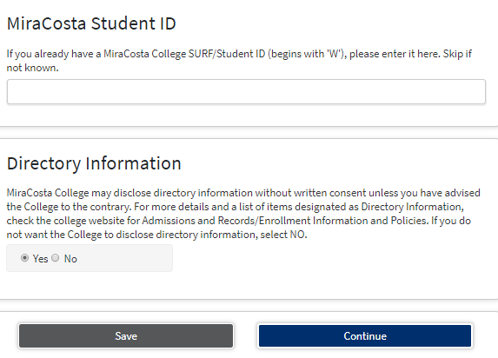
MCC Online application
Supplemental Questions (2 of 2)
If you have been a student at MiraCosta College and know your ID number (we call it a SURF ID and it will be an Upper-case W followed by 7 digits) you can list it here.
If you don’t remember your ID that’s totally fine, we can match your application with your ID when we process your application.
Click here
Notes:
If you have been a student at MiraCosta College and know your ID number (we call it a SURF ID and it will be an Upper-case W followed by 7 digits) you can list it here.
If you don’t remember your ID that’s totally fine, we can match your application with your ID when we process your application.

Slide 23
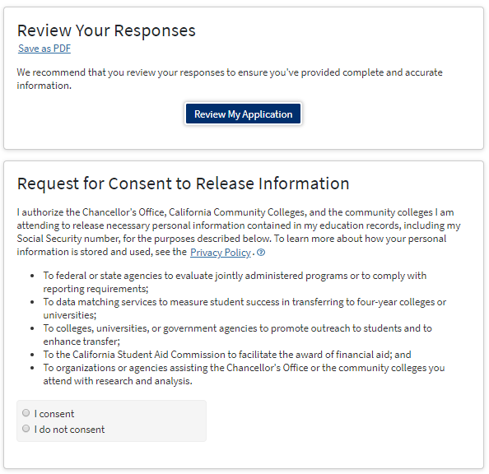
MCC Online application
Submission (1 of 2)
It’s not a bad idea to save your application as a PDF if you are able to do so.
Review your application for accuracy.
It’s a good idea to read through the Consent to Release information prior to making your decision about whether you want to consent to releasing your information or not.
Check one
Notes:
You can review and save your application as a PDF here (it’s not a bad idea in case we have questions later).
Additionally, it’s a good idea to read through the Consent to Release information prior to making your decision about whether you want to consent to releasing your information or not.

Slide 24
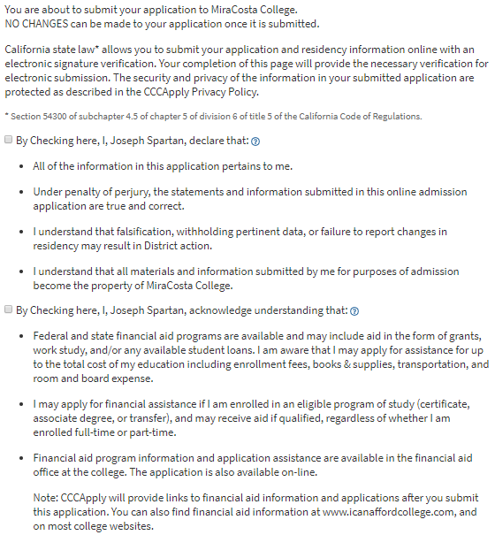

MCC Online application
Submission (2 of 2)
We strongly recommend that you read this information because it’s super important! You be required to check both of these boxes prior to clicking the ‘Submit My Application’ button.
Click to submit
Notes:
We strongly recommend that you read this information because it’s super important! You be required to check both of these boxes prior to clicking the ‘Submit My Application’ button.

Slide 25
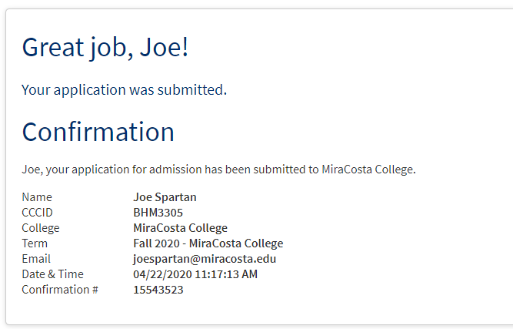
MCC Online application
Congratulations! Your application to become a Spartan is complete!
Great job!
Notes:
Congratulations! Your application to become a Spartan is complete!
Great job!

Slide 26
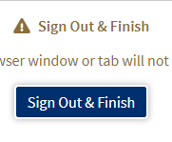
MCC Online application
If you choose to click ‘Continue’ it will take you to a brief survey about your experience with the application and will provide you with a few links to resources you may find helpful. Once you are done click ‘Sign Out & Finish’
Click here
Notes:
You may be pretty tired from all this, but if you have a minute we’d love for you to complete a brief survey about your experience with the application we can keep making it better.
Click the ‘Sign Out & Finish’ button to take the very quick survey!

Slide 27
MCC Online application
Congratulations!! You have successfully applied to become a student at MiraCosta College.
You will receive an email in about 2-5 days with your SURF ID
You DO NOT need to submit a Concurrent/Dual Enrollment Form if you are not in either type of those courses
After you have your SURF ID, you can create your account/login to CATEMA to get on the course roster
Application questions?
Admissions and Records
760.795.6620/email: Admissions@miracosta.edu or chat on our
website.
Articulation questions?
Amy Pimentel: apimentel@miracosta.edu
Notes:
Once your application has been processed you will receive an email explaining the steps necessary to become a successful student.
This will take approximately 2 days.
Remember to check your email and most importantly READ YOUR EMAIL. We promise we’ll only email you when it’s super important.
Also, remember, we’re here to assist you. You can reach out to us via phone, chat or email!

