Slide 1
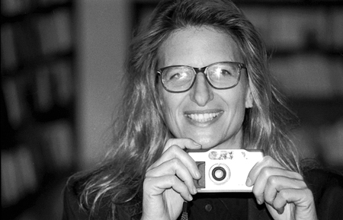
Annie Liebovitz
Narrative and Studio Portraiture

Slide 2
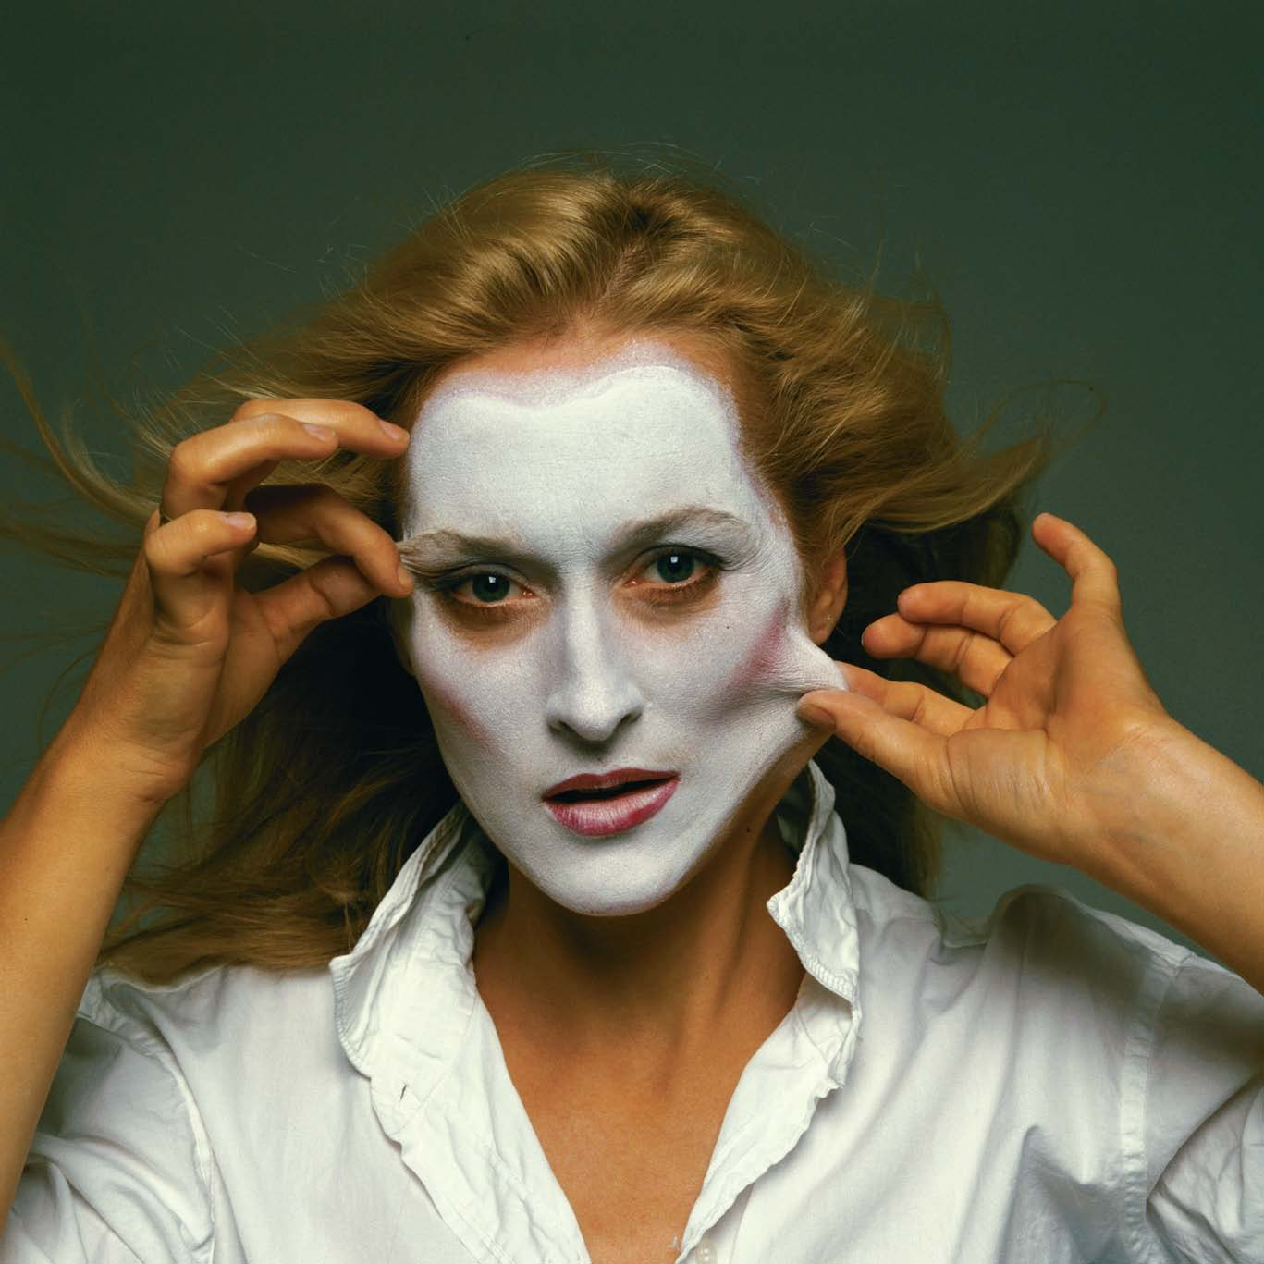
Meryl Streep

Slide 3
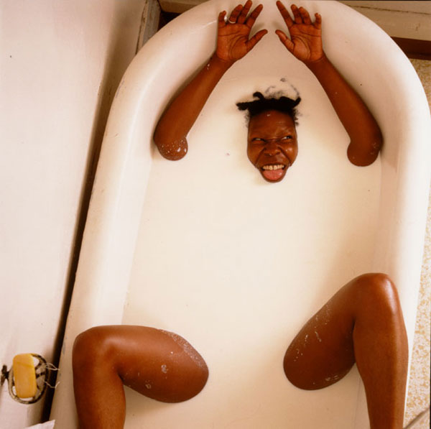
Whoopi Goldberg

Slide 4
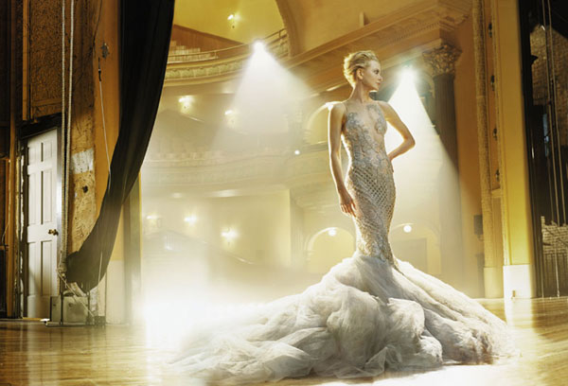

Slide 5
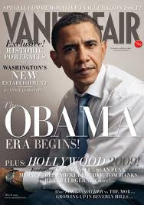

Slide 6
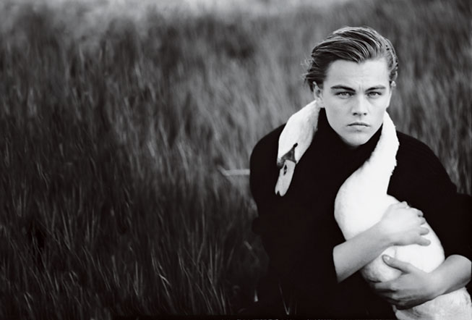
Leonardo Di Caprio

Slide 7
Bette Midler

Slide 8
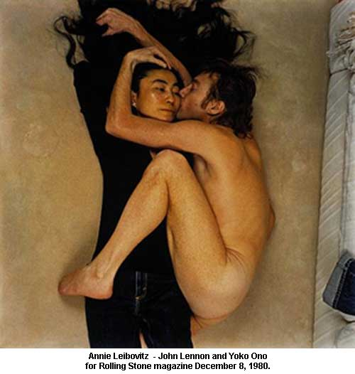

Slide 9
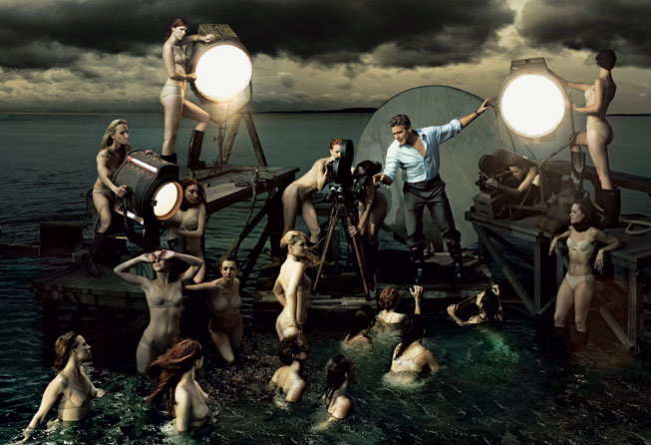

Slide 10
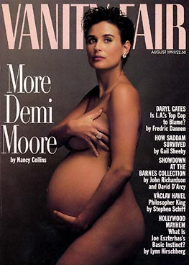

Slide 11
Hope Solo – USA World Champion Soccer

Slide 12
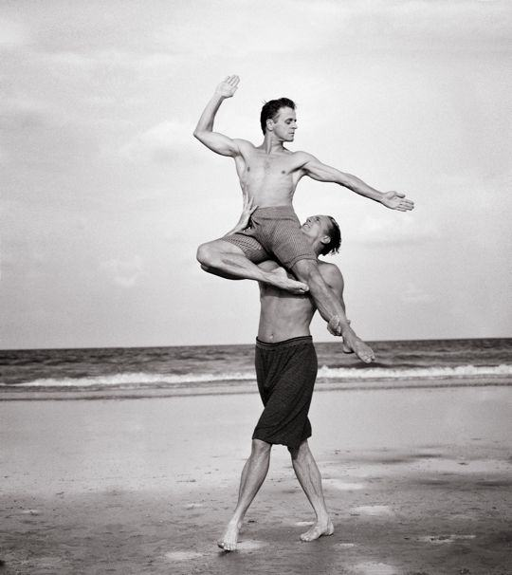
Mikhail Barishnikov

Slide 13
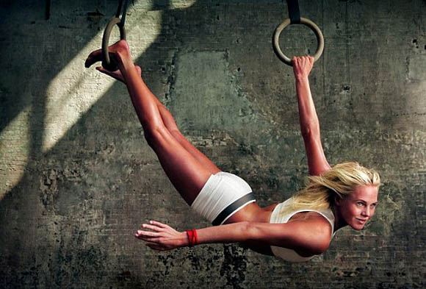
Laura Enever – Pro Surfer, Australia

Slide 14
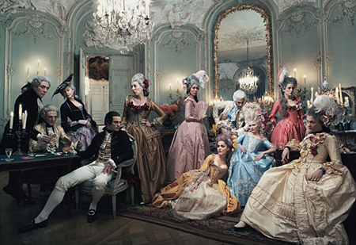

Slide 15
