Slide 1
Abstract Painting & Abstract Light Painting

Slide 2
Abstract Art
Art that does not attempt to represent recognizable reality but seeks to achieve its effect using shapes, forms, colors, lines, and textures.
It does not look like anything recognizable.
Emphasize elements of art like line, color, shape, form.
Emphasize principles of design like movement, pattern and repetition.

Slide 3
Wassily Kandinsky Yellow Red Blue 1925

Slide 4
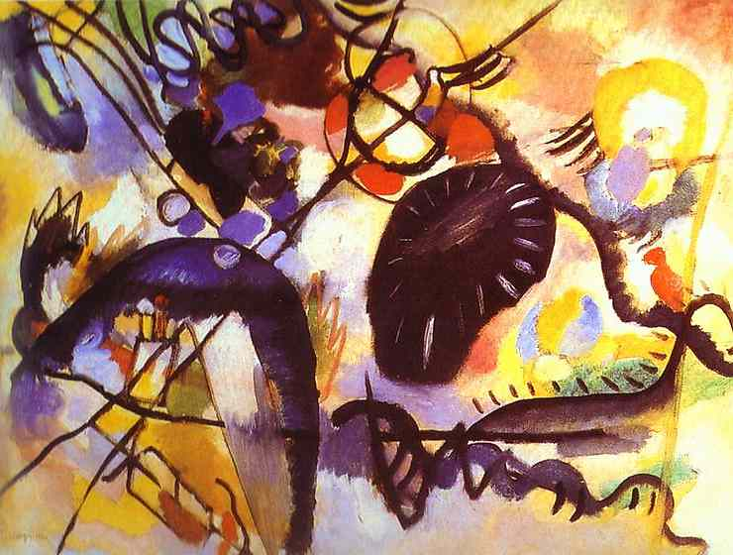
Black Spot 1912

Slide 5
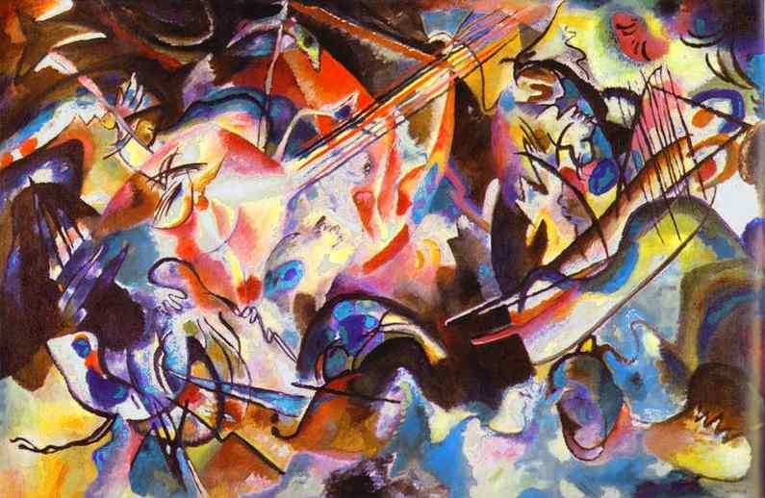
Composition VI 1913

Slide 6
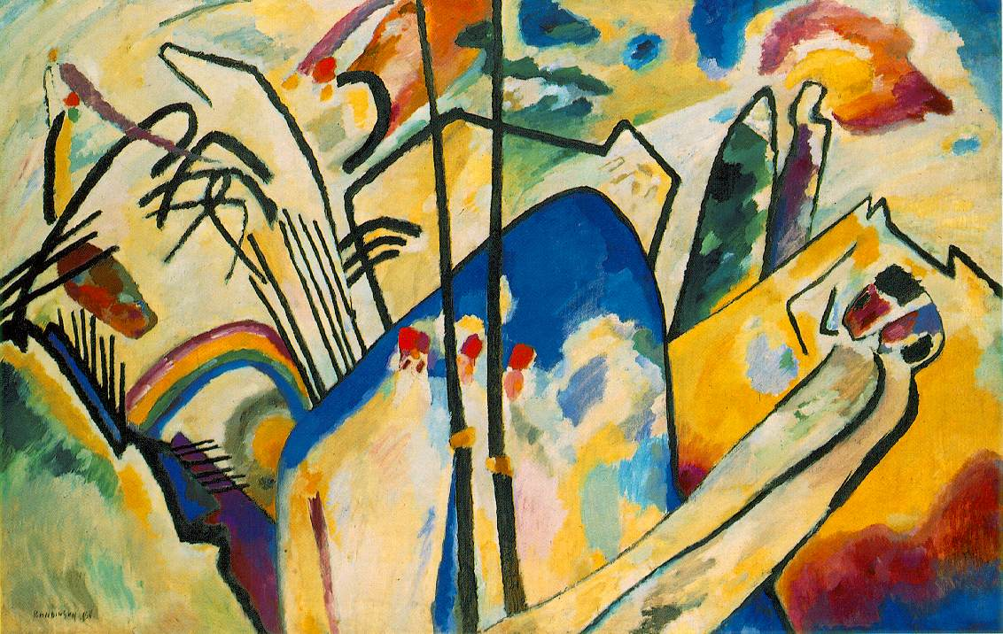

Slide 7
Jackson Pollock Number-8

Slide 8
“She-wolf”

Slide 9
Abstract Light Painting

Slide 10
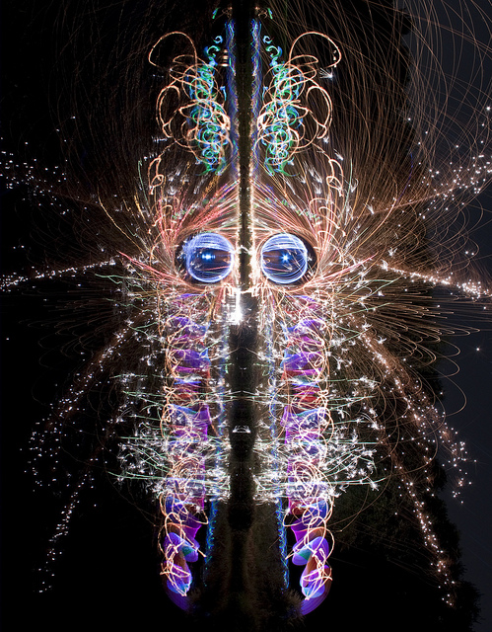

Slide 12
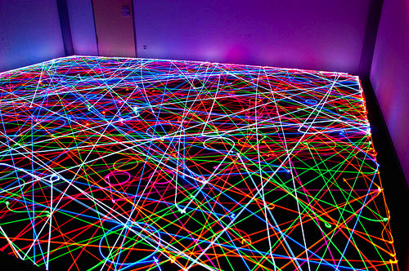

Slide 13
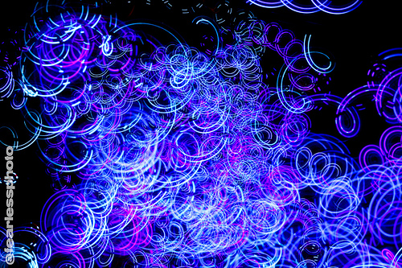

Slide 15
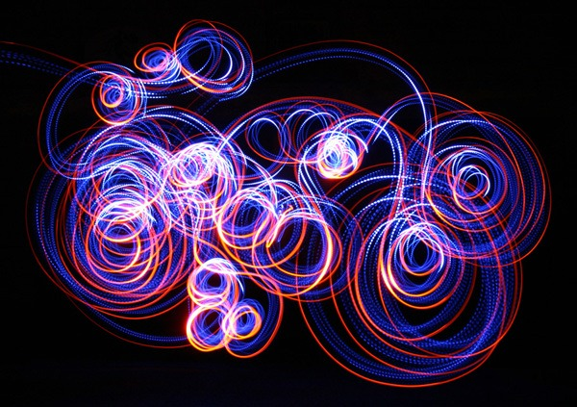

Slide 16
