Slide 1
2D Design Concentration Examples
2010-2011

Slide 2
What is the central idea of your concentration? I explored the idea of illustrating for a written narrative. In this case, the narrative is my own. I enjoy the concept of combining creative writing with the visual arts, and focused on the narrative and schematic aspect of the works: how it characterizes and tells a story. The artworks are arranged in the order that they would appear in the book. How does the work in your concentration demonstrate the exploration of your idea? You may refer to specific images as examples. When referencing specific images, please indicate the image numbers. I took inspiration from common visual elements of fantasy novels. For example, image 1 is of a map, a tool utilized by many famous fantasy works (like the Lord of the Rings). Image 2 is a chapter title artwork, which is used on a smaller scale in books such as Harry Potter or Fablehaven. Images 3, 4, and 12 share a common format: that of a book illustration, which works as a "snapshot" of the story's events. As I continued, I began to experiment with other ways of telling a story through visualization. For example, I tried a few graphic novel segments that could be inserted into the story (images 7 and 9). Although these are obviously polarized approaches, I attempted to unify the work through style, repeating characters, and a similar, muted color scheme (looking at the work as a whole, one might notice that the basic color composition changes as the main character moves to a new environment; it goes from green-brown, to purple, to red).
For reference, here is a short summary of the story's events: it revolves around a young girl growing up in 1940s England. When her widowed father is forced to join the army, she is suddenly transported to a strange world (this transition happens between images 4 and 5), where she must come to grips with the idea that she is unable to get back.

Slide 3
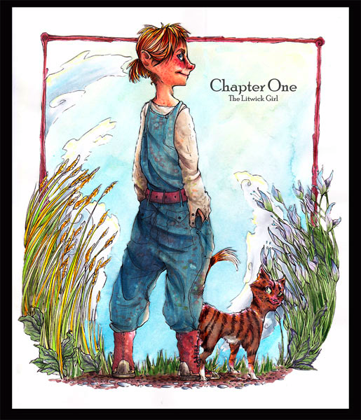
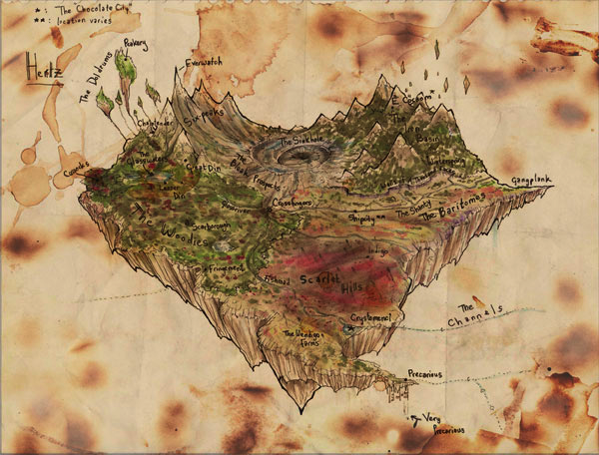

Slide 4
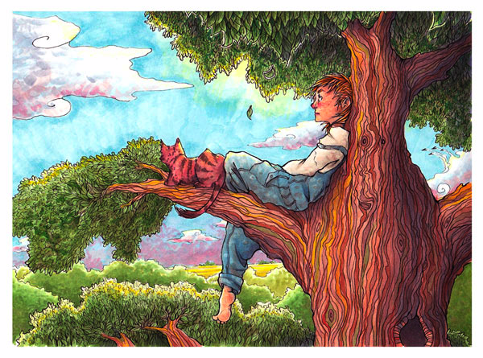
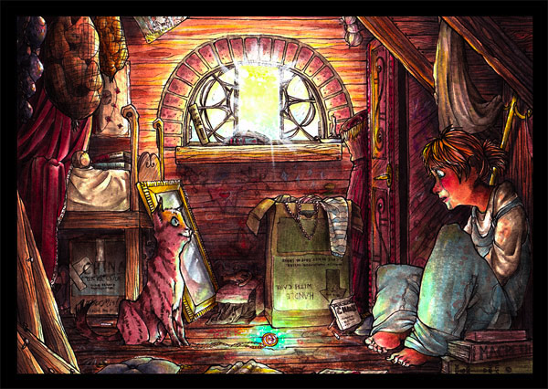

Slide 5
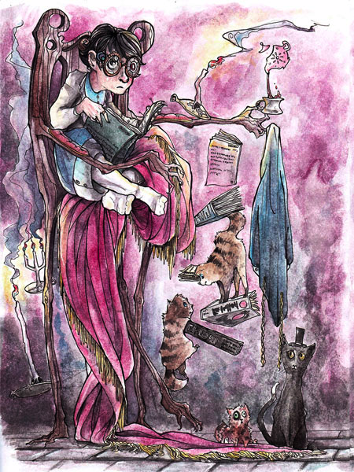
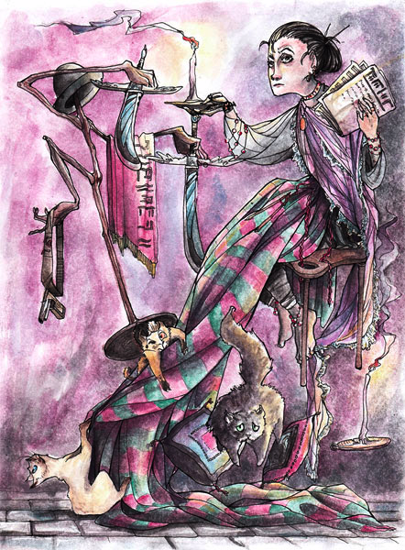

Slide 6
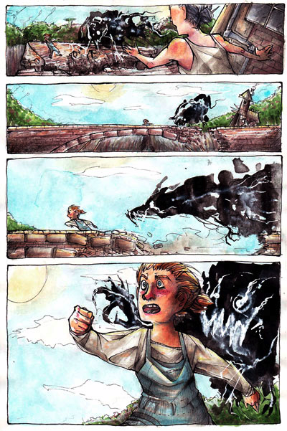

Slide 7
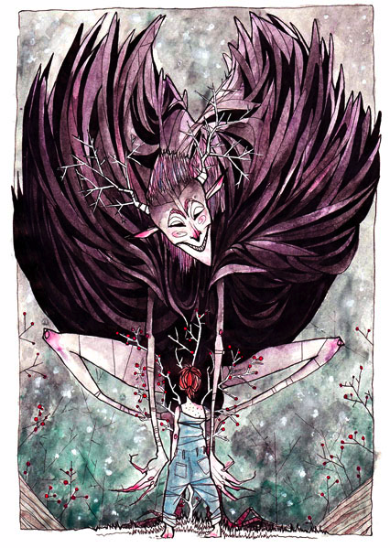
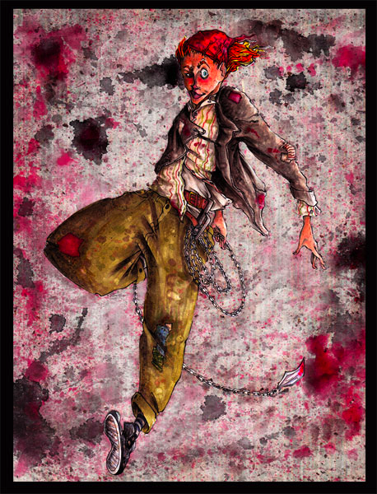

Slide 8
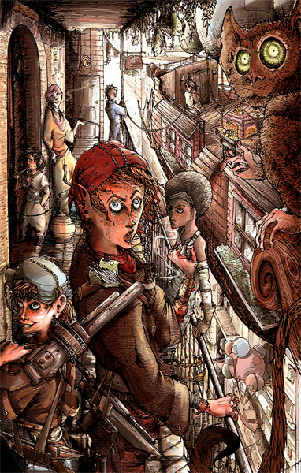

Slide 9
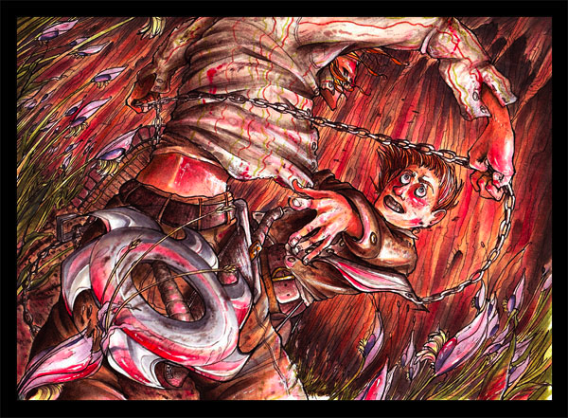

Slide 10
Rationale for Score 6:
This work presents an imaginative, original and coherently integrated narrative.
The student's voice is evocative and confident and expresses a distinct measure of success.
The work reaches a level of excellence in quality through the use of rhythm and movement as well as unity and variety.
Technical excellence and a refined use of media are evident throughout this concentration.
Overall the work is of excellent quality.

Slide 11
1. 8.5 x 11 alcohol marker, digital manipulation 2. 8.5 x 11 alcohol marker, watercolor, collage 3. 8.5 x 11 alcohol marker 4. 8.5 x 11 alcohol marker 5. 8 x 11 watercolor 6. 8 x 11 watercolor 7. 8.5 x 11 watercolor, alcohol marker, ink 8. 8.5 x 11 watercolor 9. 24 x 8 watercolor, ink, collage 10. 9 x 11 alcohol marker, watercolor, collage 11. 11 x 18 pen and ink, digital color 12. 8.5 x 11 alcohol marker

Slide 12
Student Commentary: What is the central idea of your concentration? The central idea of my concentration is that I wanted to express the travels of the "Tourist in My Mind." I've created a sort of children's book that focuses on being adventurous and being imaginative and creative, and progresses as she travels to different places. The [T]ourist visits these different locations that may not even exist, but creates a feeling of freedom and wonder. Then, finally, she returns to the safety of her own home. How does the work in your concentration demonstrate the exploration of your idea? You may refer to specific images as examples. When referencing specific images, please indicate the image numbers. In image 1, the story begins with the Tourist sending postcards to me, M.J. She appears in a river village with strong, contrasting colors. Image 3 shows the Tourist in a bustling city. I feel this piece has a lot of movement and rhythm, reminiscent of busy city life. Image 4 shows the Tourist underwater, a sunken pirate ship in the background. I think this image has a fun use of contrasting colors. There's the cool colors of the water, and warmer colors for sea life and the Tourist's hair. Next, in image 5, we have the Tourist in a hill valley with some surreal animals. This piece has many bright, warm colors that fit the mood of the freedom of open spaces. The lines and colors also create a strong sense of movement. Image 7 also uses strong, bright colors to create a fun, crazy environment on the dance floor. These colors create rhythm and movement, like the dance itself. Next, image 8 reveals a more dangerous tone, as contrasting cool and warm colors create a vibrant and exciting jungle scene. Image 9 also utilizes contrasting colors in a brilliant desert sunset. These colors create a warm, relaxed feeling, and the lines create rhythm and movement. Finally, image 12 shows the Tourist safe at home in her bed, with deep, contrasting colors that move your eye across the page.

Slide 13
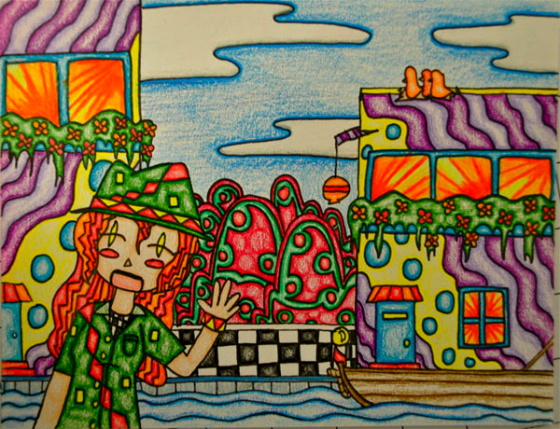
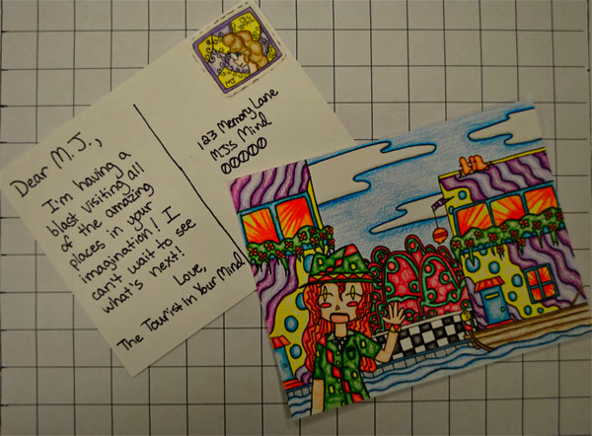

Slide 14
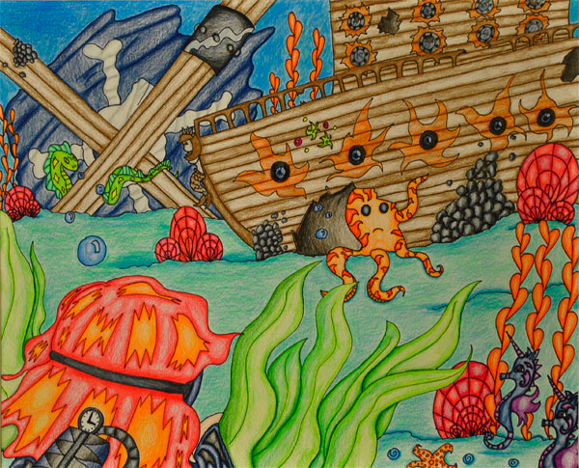
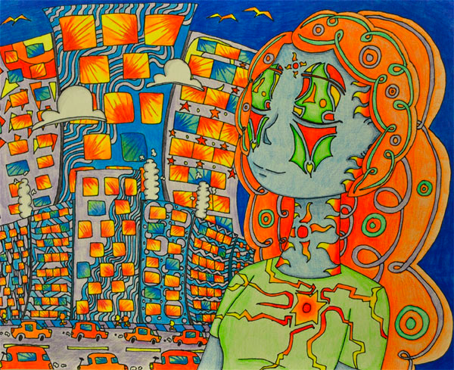

Slide 15
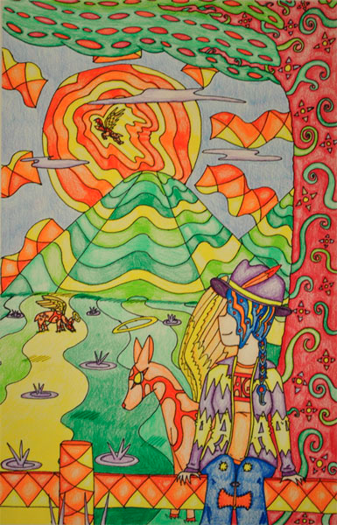
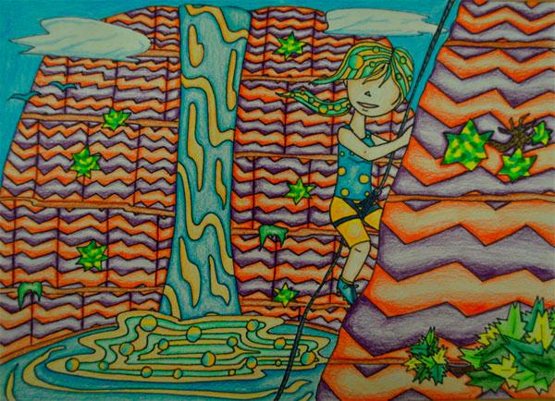

Slide 16
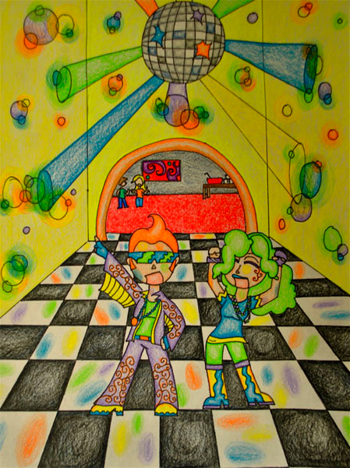
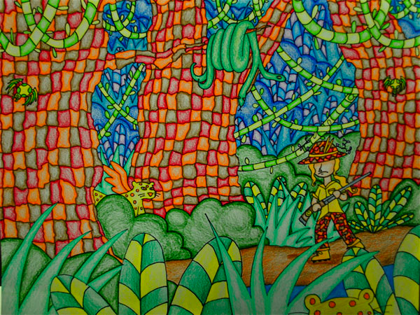

Slide 17
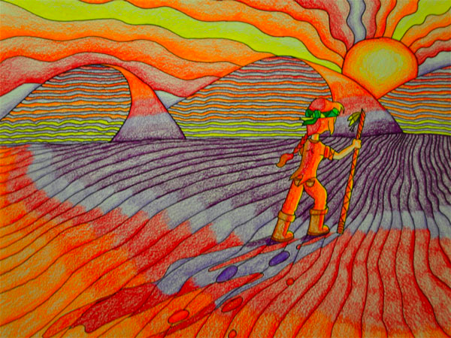
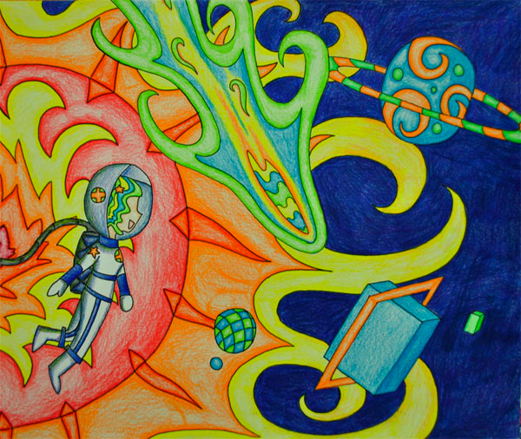

Slide 18
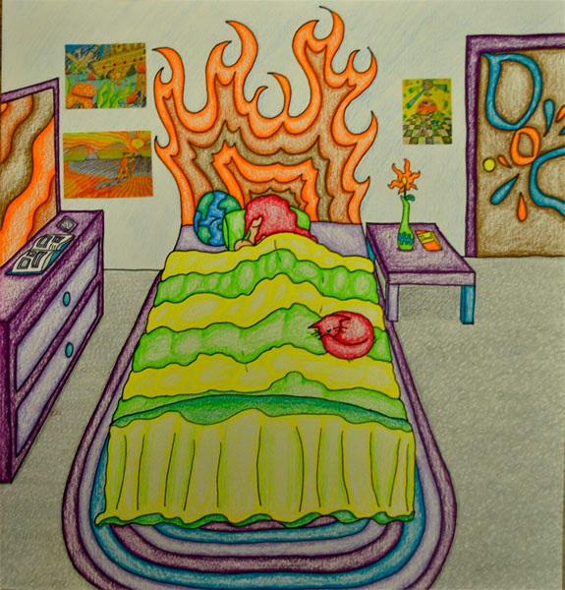
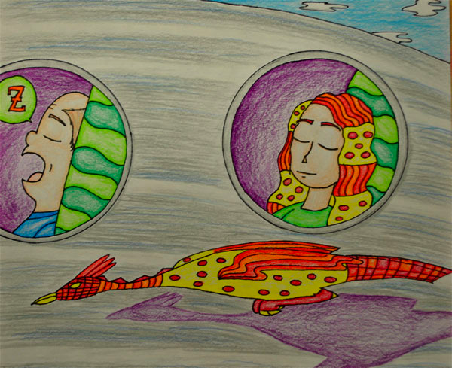

Slide 19
Rationale for Score 3:
The concentration has a theme and the work exhibits some imagination and originality.
The work is ambitious in the use of color, line, repetition and pattern.
Technical competence is emerging.
There is a lack of sensitivity in the development of the spatial environment in images 2 and 6; foreground and background are indiscernible.
Little growth or transformation is evident throughout the development of the series.
The work is of moderate quality.
All prismacolor

Slide 20
What is the central idea of your concentration? The central idea of my concentration is Incognito. Humans utilize metaphoric masks to hide our true identity. Because of this, our city becomes artificial and fake. We feel naked without them, so we have become "incognito addicts." How does the work in your concentration demonstrate the exploration of your idea? You may refer to specific slides as examples. We are surrounded by illusions and the things around us are not always what they seem to be. We use masks as a tool to become incognito, but in the process of wearing these masks, our identity could be lost. I wanted to capture in my pieces the idea that human beings rely on objects or ideas to deceive either themselves or others in order to put on another identity more suited for the world that thrives on superficial impressions. I began to first take a self-exploration and depicted how people can use the internet (Image 4) to mask themselves or my awareness of my own identity (Image 6). I then turned towards the media because the media itself is very incognito for the news that they broadcast are often opinionated and biased though we as the viewers take it in as fact. Many truths are masked by the media through reports such as those on celebrities (Image 8) and current events such as the Haiti and Chile earthquakes (Image 10). People are eager to seek acceptances of themselves, so in their attempts to blend in, they tend to conform to the group (Image 11) they want to belong to, so in that process, they lose their identity. Their individualism becomes incognito.

Slide 21
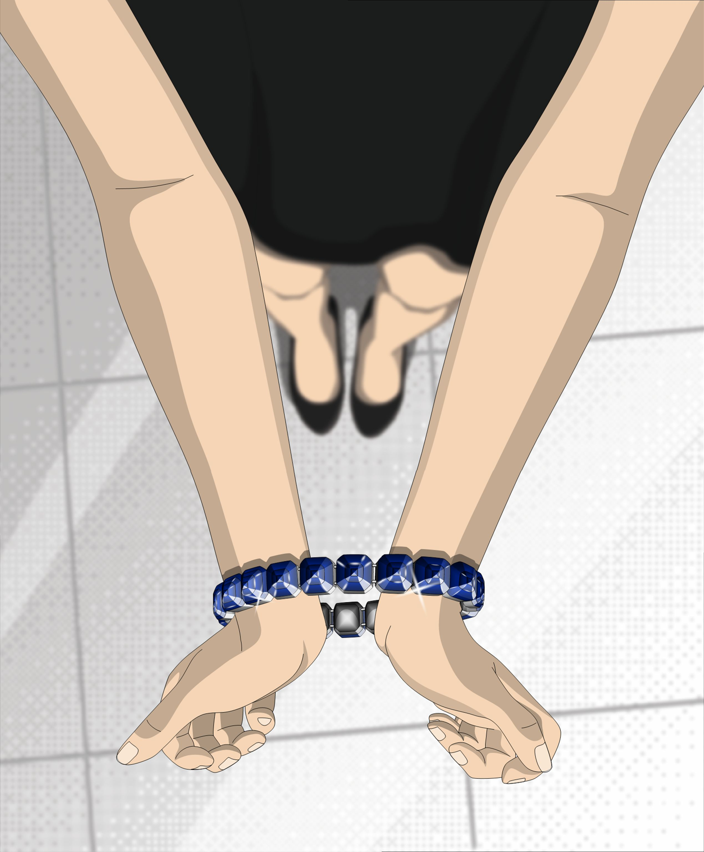
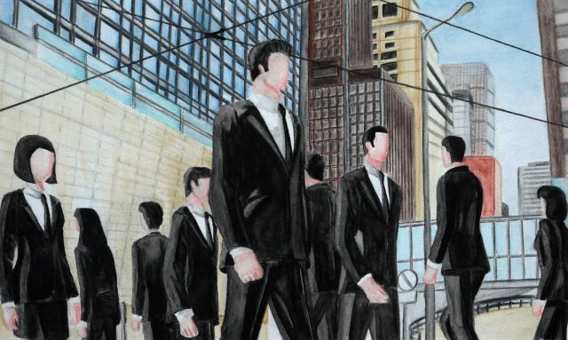

Slide 22
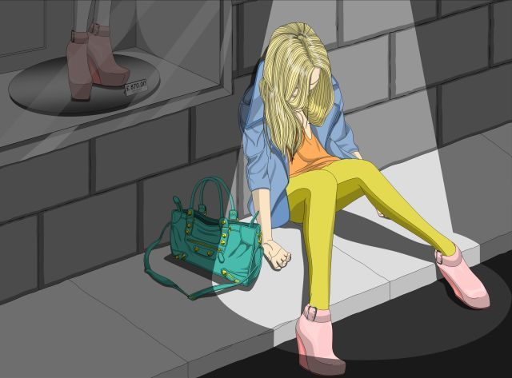
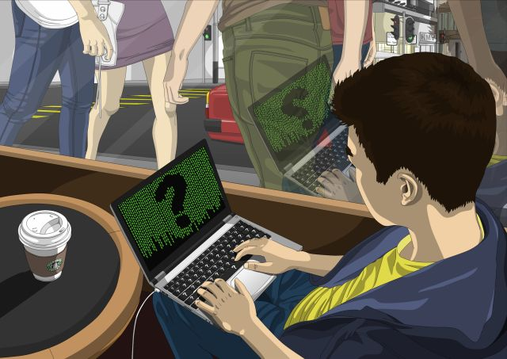

Slide 23
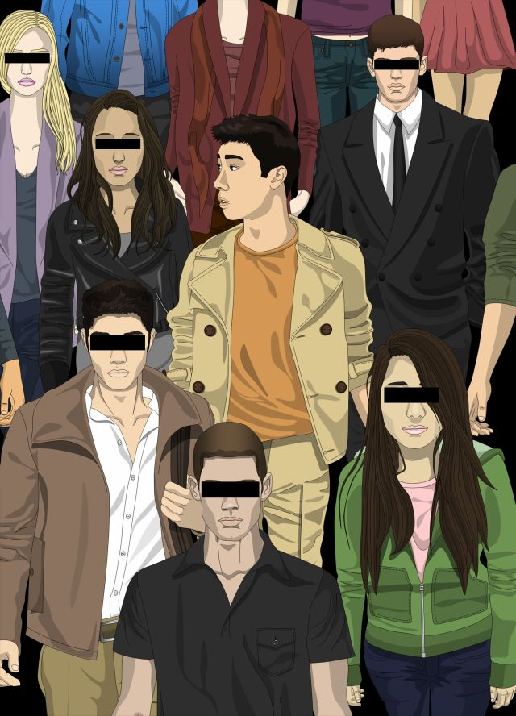

Slide 24
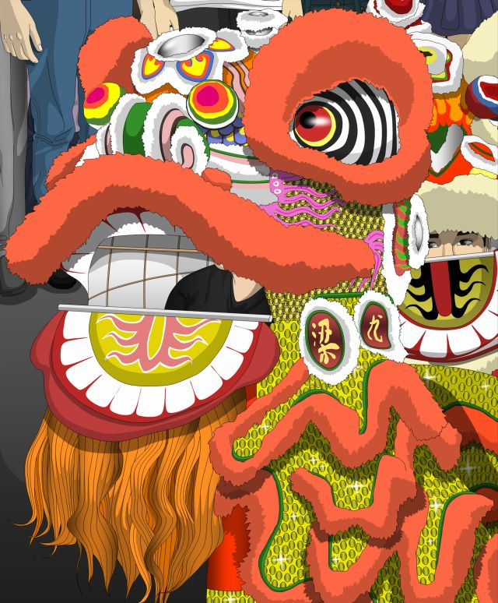
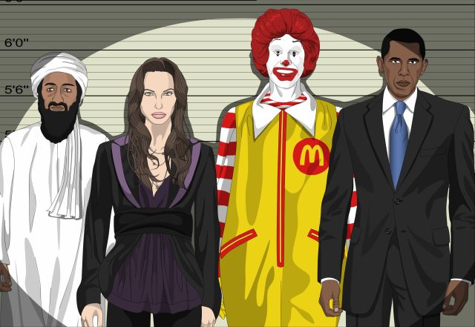

Slide 25
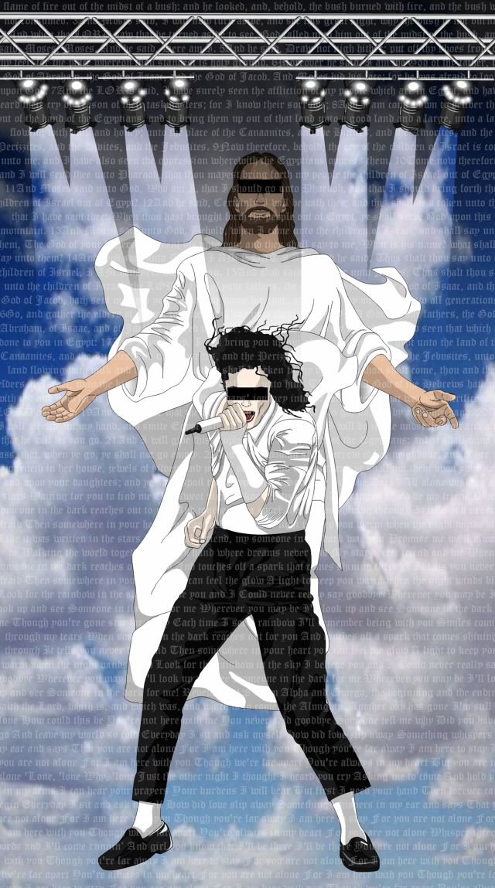
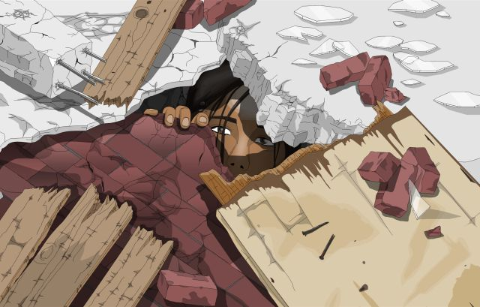

Slide 26
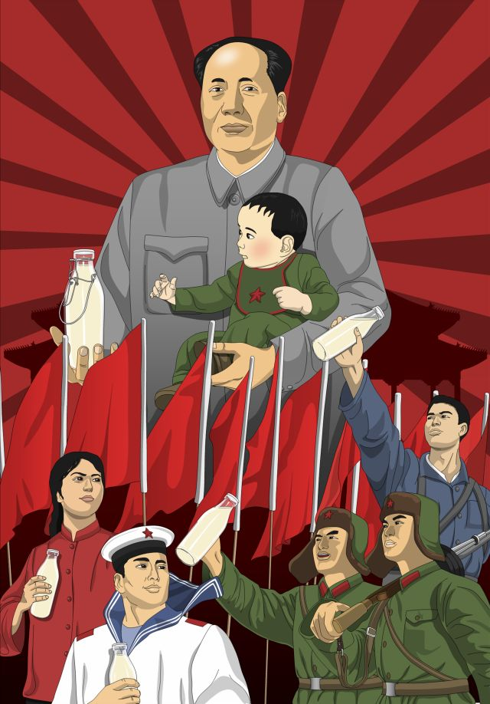
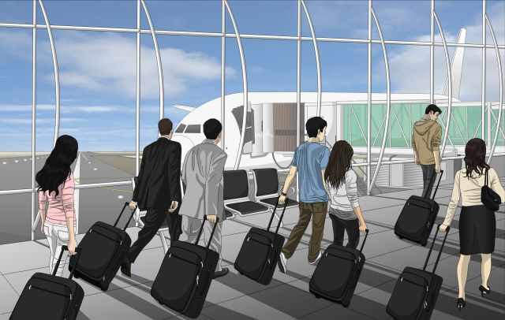

Slide 27
Rationale for Score 6:
The theme and technical skills are excellent, and the student's voice is prominent and transcends the original photographic sources.
The commentary did not contribute to the grading; the excellent designs and social statements in the work itself demonstrate an original vision and risk taking.
The repetition, contrast, emphasis and figure/ground relationships reveal informed decision making and effective use of two-dimensional design principles.
The work presents an original vision.

