Slide 1
Sequence Photography
Stopped Motion

Slide 2
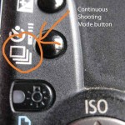
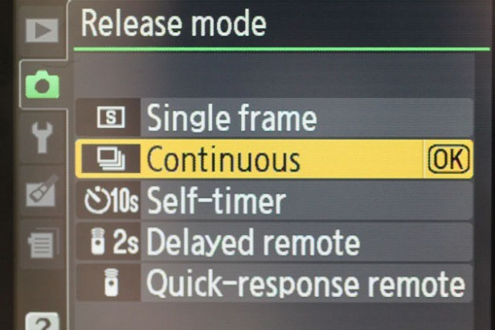
Shooting a Sequence:
Set your camera mode to “Continuous Shooting” or “Burst.”
Choose your frames per second (fps) or how many shots will be taken in rapid succession.
Pre-focus on your subject- or estimate where the subject will be and pre-focus there.
Hold down the shutter until the action is completed.

Slide 3
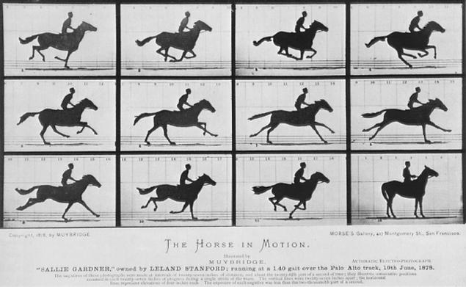
Sequence – Motion Study
1878 Eadweard Muybridge

Slide 4
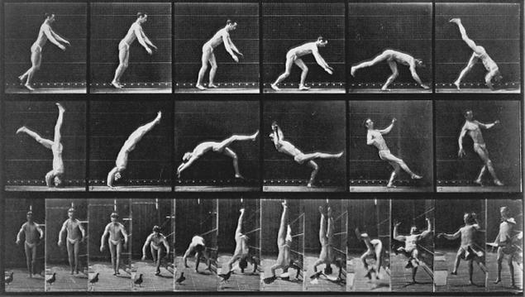
1885 Eadweard Muybridge

Slide 5
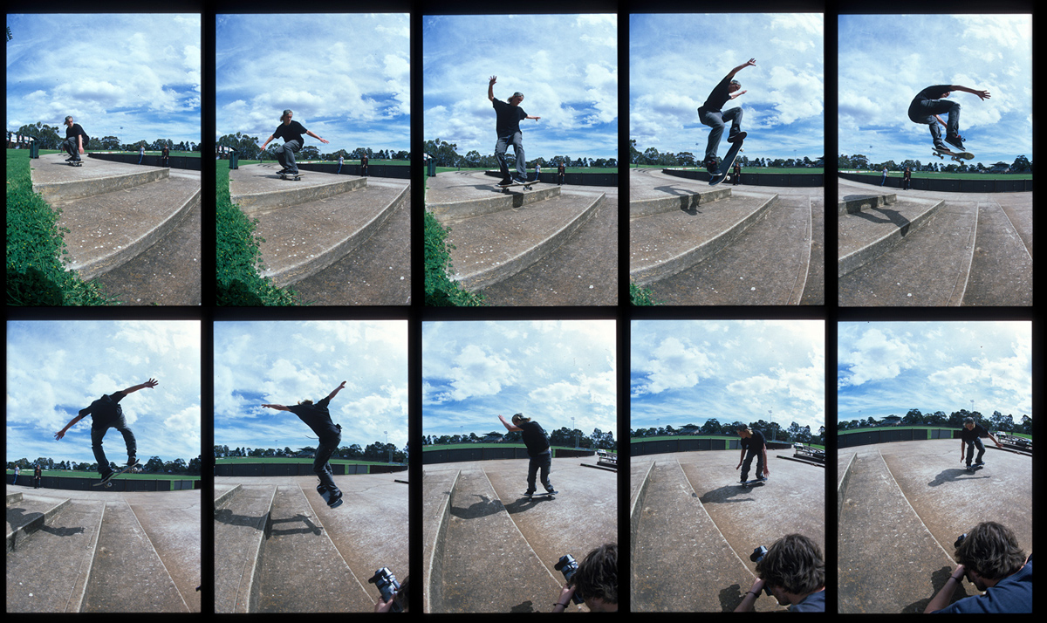

Slide 6
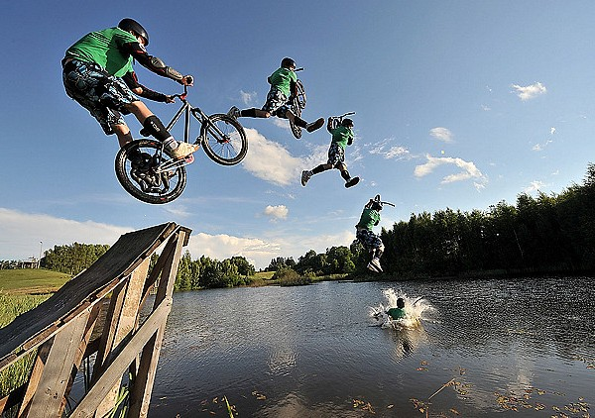

Slide 7
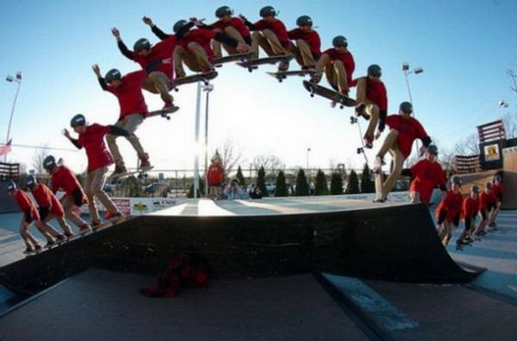

Slide 10
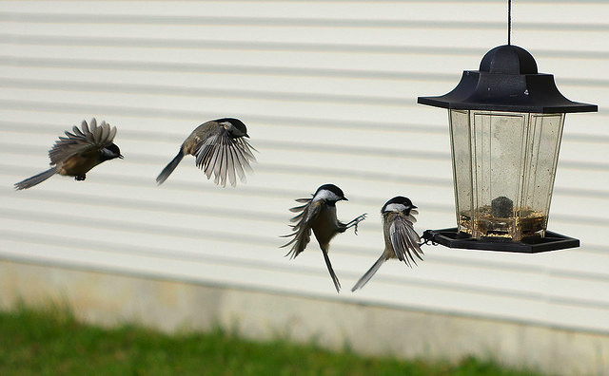

Slide 12
