Slide 1
Light Trails

Slide 2
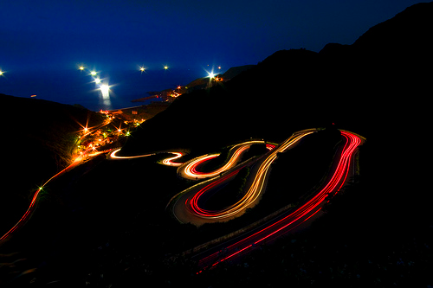

Slide 3
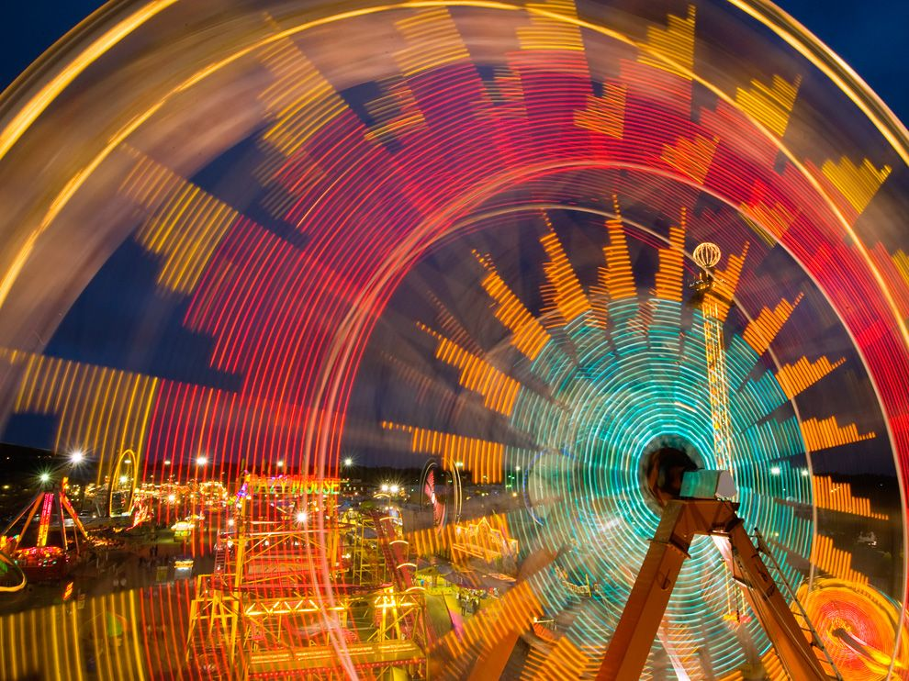

Slide 4
Shooting Light Trails
What you need:
Camera on shutter priority or manual
Tripod (or stable surface to rest the camera on)
A location where cars frequent
Option – lens hood on your camera to block out ambient light

Slide 5
Preparation for your shot:
Timing/Light:
Middle of the night or
when the sun is almost set and right after it sets. You can capture the lights from the cars and ambient light in the sky.
2) Creative Viewpoint:
Find a location to create an interesting vantage point. Bug’s eye or bird’s eye.
Bird’s eye: Set up on a hill, overpass, roof and look down on the cars and city lights.
Bug’s eye: looking up at a carnival ride, flashing marquee signs

Slide 6
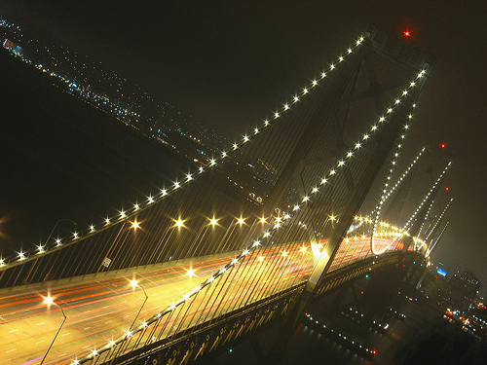
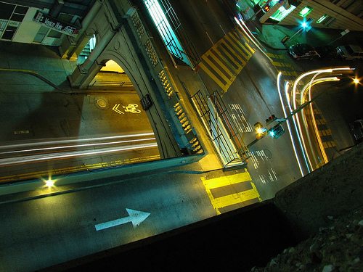

Slide 7
3) Location: Choose a location with interesting moving lights. Carnival/fairgrounds, roads that curve, roads that converge, bridges that pass over each other, roads that create S curves…
4) COMPOSITION: use the rules of composition.
Think about how the background elements should complement the light trails.
Frame the scene so that the trails or lines created by the lights will lead the eye in your photo. Leading lines to corners, S curves, etc.

Slide 8
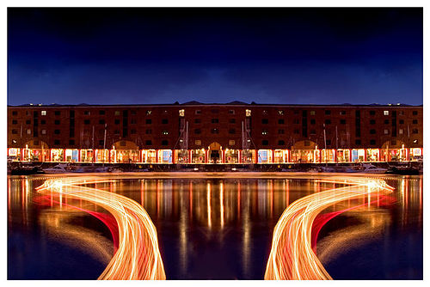

Slide 9
Camera Settings:
Shutter priority or manual
Shutter speed between 10 and 20 seconds
Aperture in the middle – around f8
Low ISO
Manual Focus: pre-focus your shot on an interesting part of your composition before the cars pass through the frame
If your shots are overexposed – decrease your aperture (increase the f stop number)
or if your shots are underexposed- increase your aperture (decrease the f stop numbers).
If you want the car’s lights to go further through the frame: use a longer shutter speed

