Slide 1
Impressionist Photography

Slide 2
The Impressionism Movement:
Impressionism is an art movement that began in the 19th century with the works of Monet whose painting "Impression, Sunrise" gave rise to the name of the art movement.
Impressionist photography tries to convey the feeling of a scene, a general impression, or suggestion of a scene.
Lacking in detail these impressionist images emphasize color over line and are often soft, dreamy, and have a painterly feel.

Slide 3
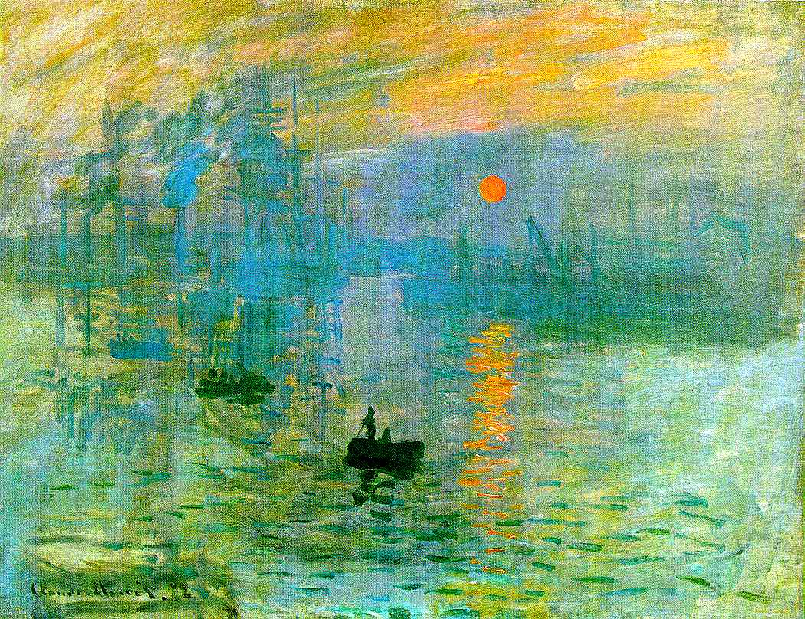
Claude Monet – “Impression, Sunrise”

Slide 4
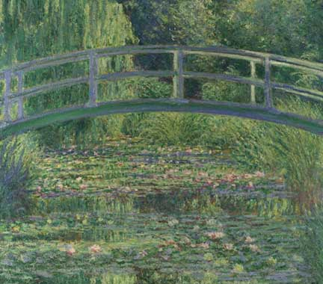
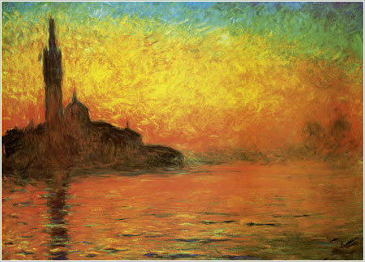
More Paintings by Claude Monet

Slide 5
IImpressionist Photography
Eva Polek

Slide 6
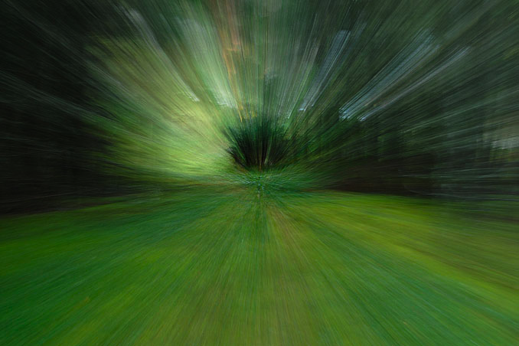

Slide 8
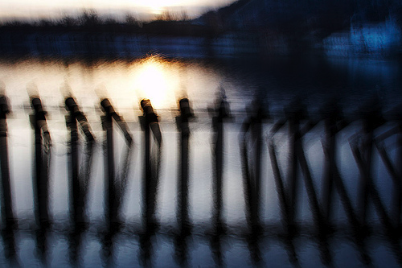

Slide 9
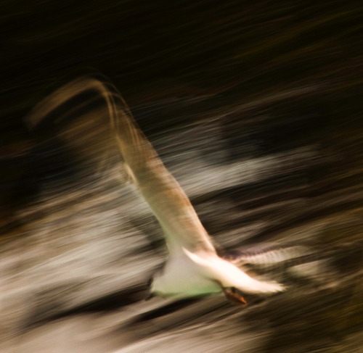

Slide 10
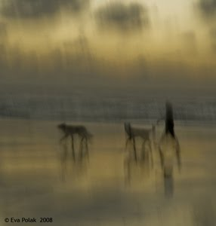

Slide 11
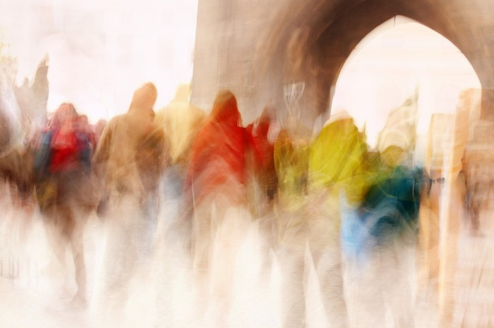

Slide 13
Camera Shake

Slide 14
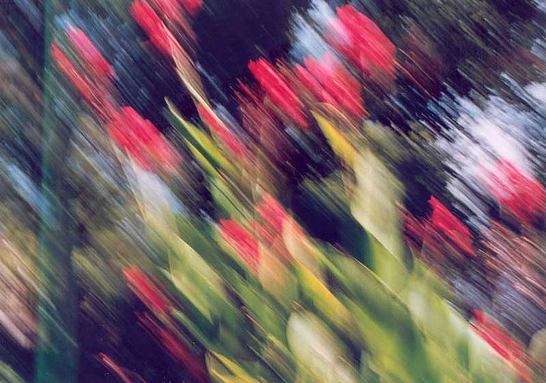
Camera Shake

Slide 15
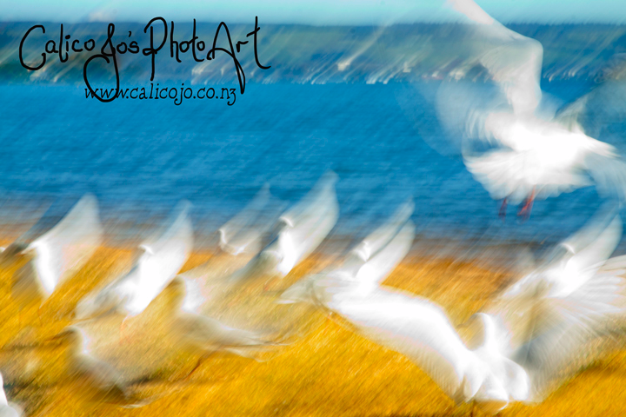

Slide 16
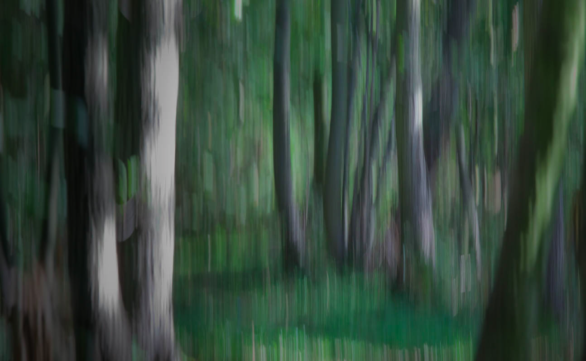

Slide 17
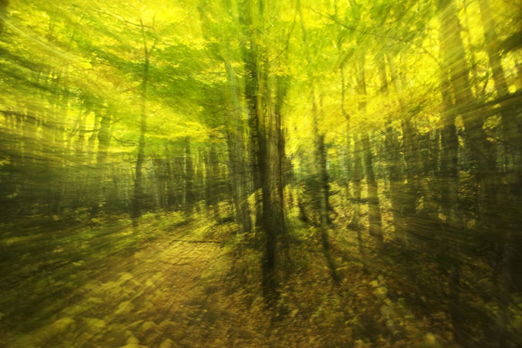
Zoom while shutter is open

