Slide 1
Fill Flash

Slide 2
Fill Flash
Using a flash in fast moving environments can help you achieve well exposed images:
using both the light of the flash to fill out shadows
as well as the natural light in the scene

Slide 3
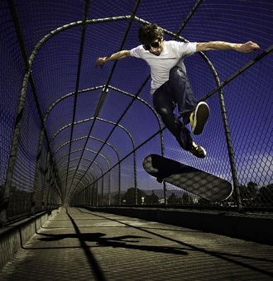

Slide 4
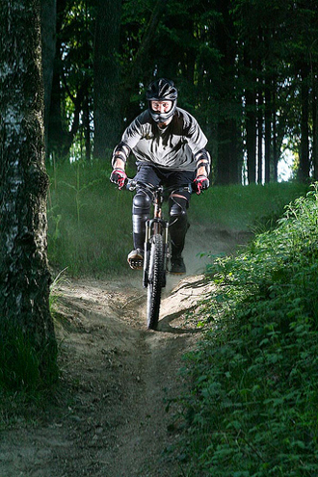
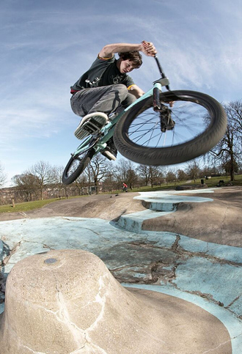

Slide 5
Fill Flash
Forcing the flash to fire is a quick and easy way to create two centers of interest:
The sky can provide one point of interest in the background.
The subject that is within your flash range will be well exposed.
The area between the two goes dark.

Slide 6
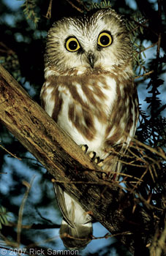
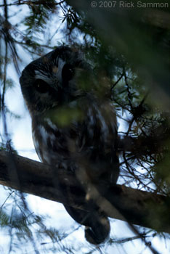

Slide 7
Flash Range
Every camera with a built-in flash has a very limited range
When you use your zoom lens, you reduce that range—check your camera manual to find out what it is.
Typically, the flash will work up to about 20’-30’ with the lens at a normal setting but only up to about 7’-15’ with the lens set at telephoto.

Slide 8
Fill-Flash and Portraits/People
If you are forced to take pictures of people in bright sun, using the flash will help lighten the hard shadows and provide more detail.
It makes for an easy trick to darken backgrounds and isolate people as well.
It can give your subject a flattering “halo” effect.
Remember that what is in good light, will be the most prominent part of your picture.

Slide 9
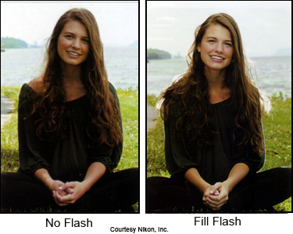
Fill Flash
Press the flash button (lightning bolt) to open the flash.
In M, Av, or Tv modes balance your meter, and focus.
Press the +/- button and the flash button and turn the dial at the same time to change the power of your flash.

Slide 10
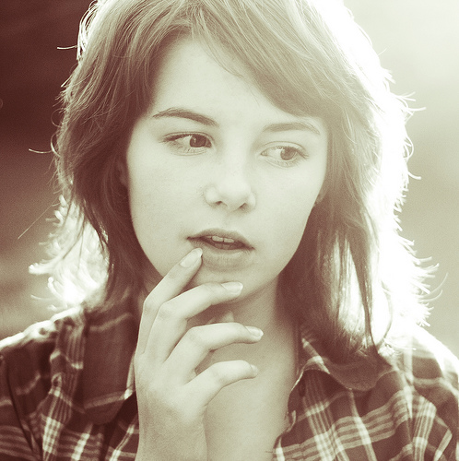

Slide 11
Exercising Some Control
There are two basic ways to control light for creative or expressive purposes:
Shift your subject in relation to the light.
Shift the light in relation to the subject.
Obviously, when you are working in sunlight the second option presents a problem.

Slide 12
Using Reflectors
For small subjects, including portraits, carrying something to use as a reflector is handy
Use a reflector:
or a white piece of posterboard
a white umbrella
plain white sheet can be used to reflect additional light into the shadows of a bright sunlit subject.

Slide 13
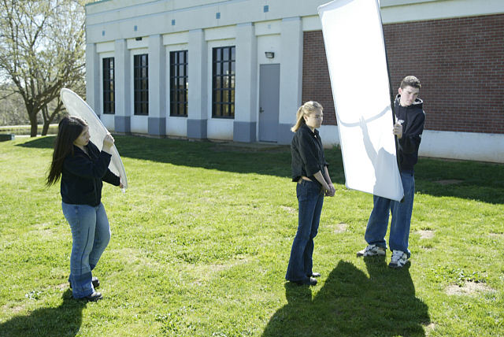
Having Assistants Helps

