Slide 1
Exposure Techniques Project

Slide 2
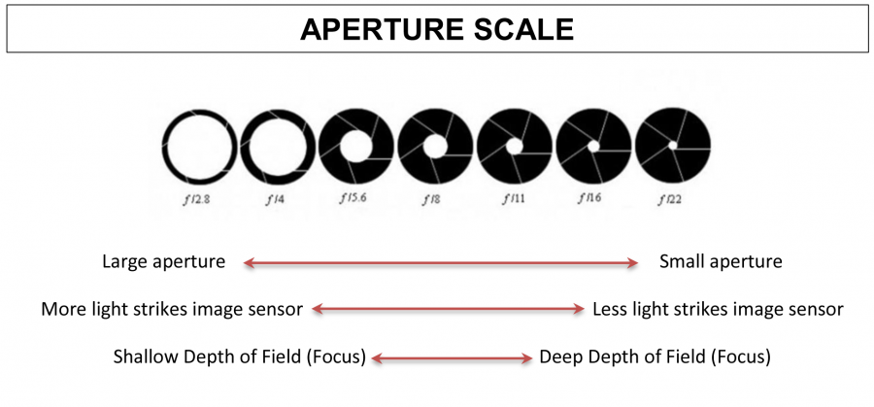
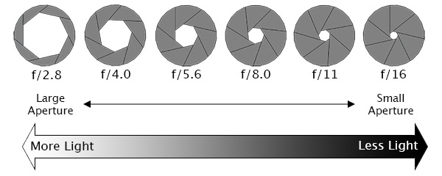

Slide 3
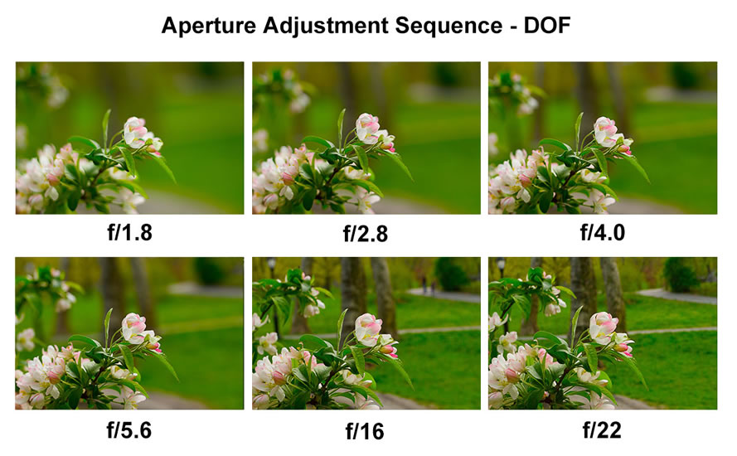
1) Aperture & DOF:
Shoot 5 photos of the same subject/scene at the following apertures: f/5.6, f/8, f/11, f/16, f/22
Use Aperture Priority Mode Av
Use manual Focus
5 shots total

Slide 4
Tips for Small DOF photographs:
Aperture: 4.5 (or as small as you can get on your camera)
Move in close to the subject
Try zooming in on the subject.
By keeping the subject far from the background, the more shallow the background becomes.
Put your camera in Manual Focus and you control what areas are in focus

Slide 5
Shutter Speed:
How long the shutter is open to light.
Fast shutter speed freezes movement. (ie 1/250-1/500)
Slow shutters blur movement (2 sec – 1/30 seconds)

Slide 6
2) Shutter Speed:
Find or stage a scene with motion you can shoot 5 times. (Running water works well. Streams, rivers, fountains, waterfalls, a friend on a bike, someone performing an action like flipping, jumping, spinning, swinging on a playground, merry-go-round, etc.)
Shutter priority mode Tv
Manual Focus
Use a tripod or stable surface
Shoot the scene at the following shutter speeds: 1/500, 1/250, 1/60, 1/30, 1/5.
5 shots total

Slide 8
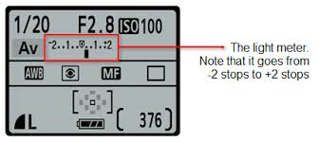
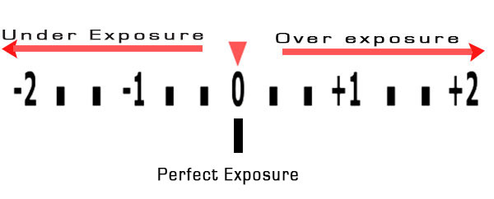
Light Meter:
Calculates the amount of light falling on the image sensor
In Manual Mode: zero out the meter for “correct” exposure.

Slide 9
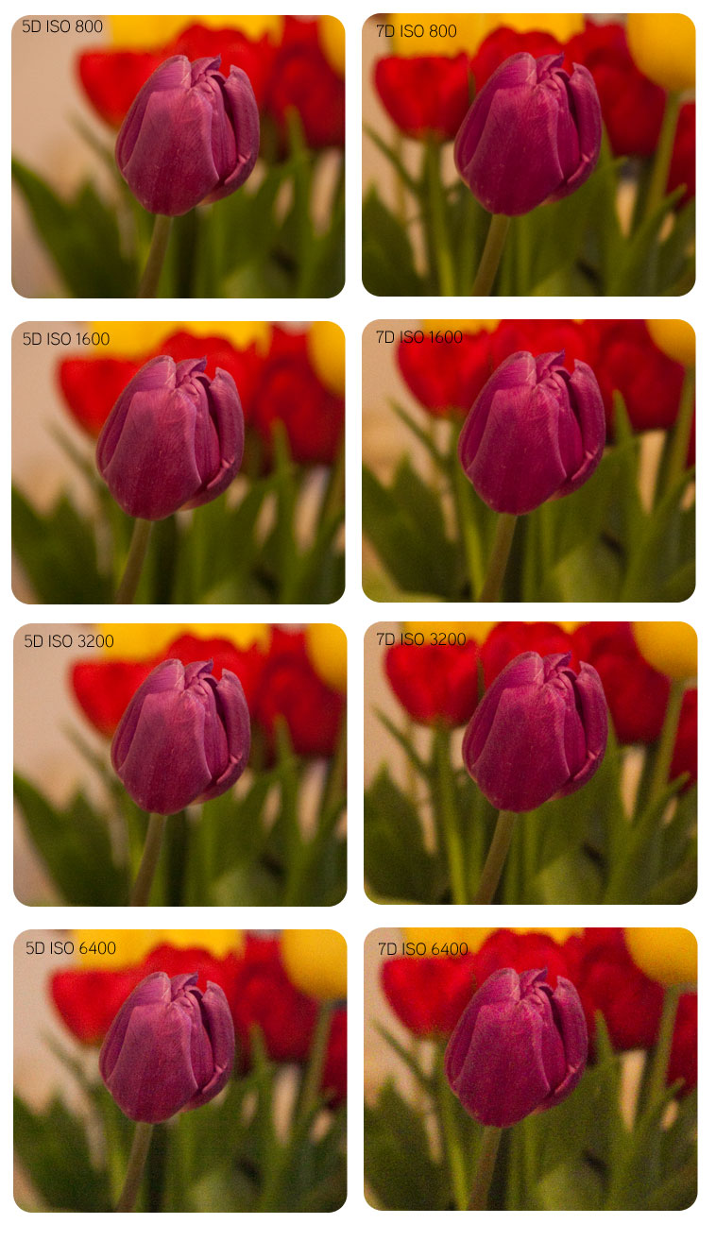
3) ISO:
Set up a subject you can shoot multiple times.
Use Manual Mode
Use Manual Focus
Set your ISO at 100
Balance your light meter and take your shot.
Repeat this at ISO 400, 1600, 3200
Use a tripod or stable surface
4 shots total

